Slide 1
KEYNOTE-024: Pembrolizumab vs. Chemotherapy for PD-L1-Positive Non-Small-Cell Lung Cancer
Caroline Gentile, MS1
Icahn School of Medicine at Mount Sinai

Slide 2
Disclosures
I do not have conflicts of interest to disclose for this presentation.
I affirm that all discussions of drug use will be consistent with either FDA or compendia (i.e. medical textbook, published medical literature, professional society guidelines) approved indications

Slide 3
Presentation Outline
Overview of NSCLC
Case
PICO
Background
Methods and Internal Validity
Results
External Validity and Application
Summary

Slide 4
Overview of NSCLC

Slide 5
Lung cancer is the leading cause of cancer-related mortality in the United States. 85% of lung cancer cases are NSCLC.
Lung Cancer
Small Cell Lung Cancer (SCLC)
Non-Small Cell Lung Cancer (NSCLC)
Smaller size under the microscope
More aggressive
More resistant
More difficult to treat
Adenocarcinoma
Squamous cell carcinoma
Large-cell undifferentiated carcinoma
Larger size under the microscope
Less aggressive
Less resistant
Less difficult to treat
Notes:
Lung cancer is the leading cause of cancer-related mortality in the US
SCLC and NSCLC: NSCLC accounts for approximately 85% of all cases of lung cancer
Difference between SCLC and NSCLC
Size of cells under the microscope when pathologists look at them
SCLC is very aggressive and grows quickly because of Ki-67
SCLC reacts quickly to treatments but can also become more resistant
NSCLC is much more common and has a higher survival rate and has more treatment options!
3 main types
Adenocarcinoma
Squamous cell carcinoma
Large-cell undifferentiated carcinoma
The lowest and highest incidences of lung cancer are where the lowest and the highest smoking prevalence are also found: in Utah and Kentucky, respectively.
Symptoms of lung cancer typically do not appear until the disease is already in an advanced stage

Slide 6
Smoking is an important risk factor for lung cancer.
From https://www.cdc.gov/mmwr/preview/mmwrhtml/mm6036a3.htm

Slide 7
Symptoms typically do not present until advanced stage of disease.
Cough (often with blood)
Chest pain
Wheezing
Fatigue
Loss of appetite
Weight Loss

Slide 8
Case

Slide 9
A 67-year-old woman presents to the hospital with six months of hemoptysis and 2 weeks of word-finding difficulties and short-term memory loss.
PMH: osteoporosis; hysterectomy for benign fibroids
PSH: None
ROS: All negative
Allergies: NKDA
Meds: None
Social Hx: lives alone, widow, works as a babysitter, never a smoker
She had been seen by doctors in the past, who had recommended a chest CT that her insurance did not approve.

Slide 10
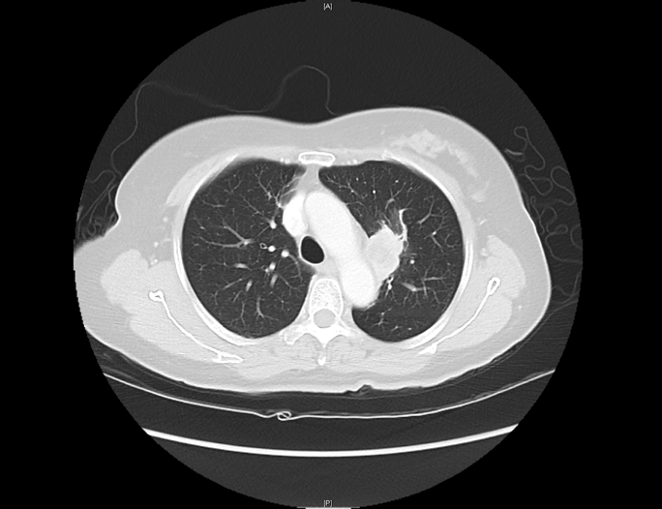
Chest CT was significant for large 4cm paramediastinal mass with necrotic center as well as perihilar lymphadenopathy.
Notes:
chest CT that showed four centimeter left paramediastinal mass with necrotic center as well as perihilar lymphadenopathy

Slide 11
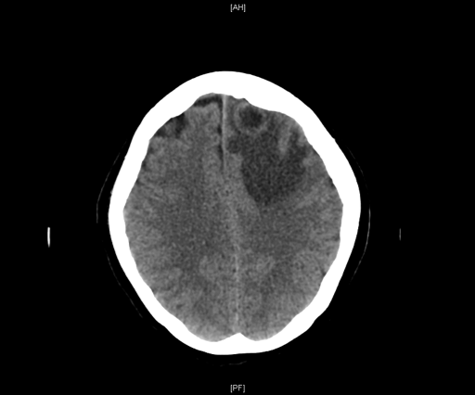
Head CT was significant for a 2cm x 1.9cm left frontal mass with surrounding vasogenic edema and subfalcine herniation.
Notes:
She had a head CT that showed 2 cm by 1.9cm mass in the left frontal lobe with surrounding vasogenic edema, and subfalcine herniation.

Slide 12
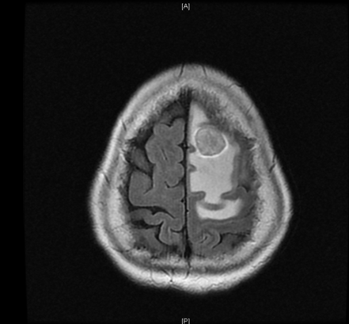
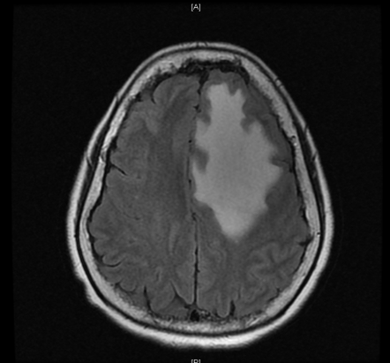
Numerous additional smaller lesions seen on MRI.
Notes:
She had a subsequent MRI of her brain that showed numerous additional, smaller lesions, most consistent with metastases.

Slide 13
The dominant brain mass was removed and evaluated. A diagnosis was made.
Tumor Evaluation
Pathology showed squamous cell carcinoma of lung origin
Tumor was evaluated for PD-L1 expression, which revealed greater than 1% PD-L1 expression.
Diagnosis: Stage 4 NSCLC

Slide 14
PICO

Slide 15
Population consisted of 305 patients who met several criteria.
Previously untreated advanced NSCLC with PD-L1 expression of at least 50% of tumor cells
No sensitizing mutation of the epidermal growth factor receptor gene
No translocation of the anaplastic lymphoma kinase gene

Slide 16
Intervention:
Pembrolizumab alone

Slide 17
Control was platinum-based chemotherapy.
Carboplatin plus pemetrexed
Cisplatin plus pemetrexrd
Carboplatin plus gemcitabine
Cisplatin plus gemcitabine
Carboplatin plus paclitaxel
Outcome: Overall survival

Slide 18
Background

Slide 19
Immune checkpoint inhibitors help the immune system better recognize and kill cancer cells.
Source: National Cancer Institute
Notes:
PD-L1 is on the tumor, PD-1 on the T cell; they usually interact to decrease T cell activity
More PD-L1 your cancer expresses, the more likely its way of evasion immune system is this way with PDL1/PD1.

Slide 20

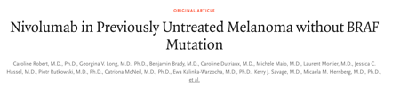


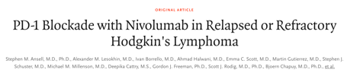
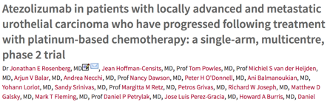
Immune checkpoint inhibitors are becoming more popular for treating malignancies.
Notes:
First approved immune checkpoint inhibitor was ipilimumab, a mAb targeting CTLA-4
Other studies showed that mAbs targeting the PD-1 and PD-L1 axis were more effective than chemotherapy in first-line metastatic melanoma, second-line advanced renal cell carcinoma, secomd-line advanced urothelial carcinoma, and refractory classical Hodgkin lymphoma, and most notably for our purposes, second-line advanced nosquamous NSCLC

Slide 21
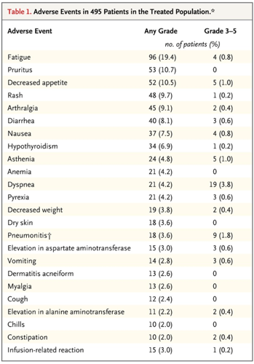
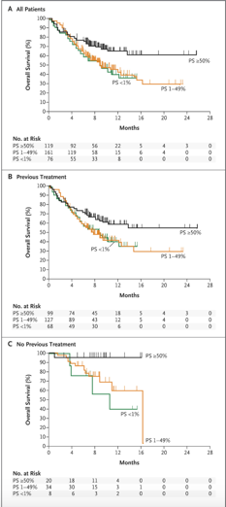
KEYNOTE-001 was a phase 1 trial that showed safety and efficacy of pembrolizumab for treating NSCLC.
Notes:
Most common side effects were fatigue, pruritis, and decreased appetite, with no clear difference according to dose or schedule.
PD-L1 expression in at least 50% of tumor cells correlated with improved efficacy of pembrolizumab.

Slide 22
KEYNOTE-010 was a phase 3 trial that showed pembrolizumab was superior to docetaxel in patients with previously treated advanced NSCLC.
Notes:
For patients with a PD-L1 tumour proportion score of 50% or greater. (B) For all patients. This brings us to KEYNOTE-024, which specifically studies NSCLC patients with tumors with PD-L1 expression greater than 50%. This is previously treated and 0-24 is untreated. Docetaxedl not platinum based

Slide 23
Methods and Internal Validity

Slide 24
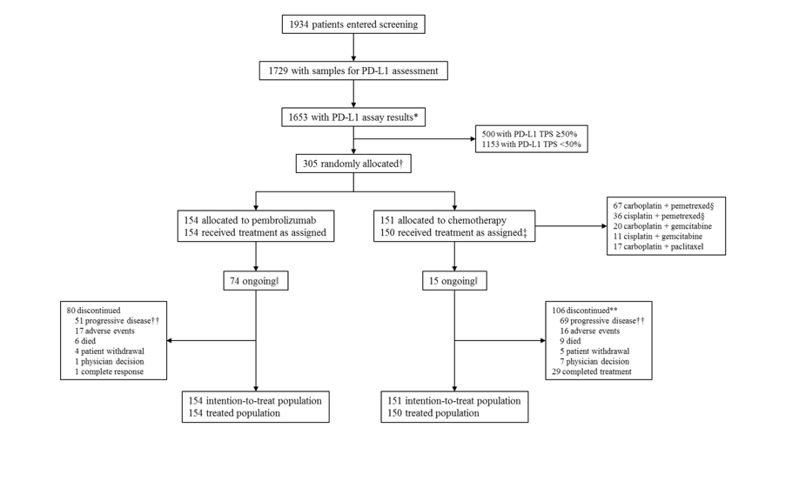
Stratified by:
ECOG score
Tumor histologic type
Region of enrollment
Notes:
Patients were randomly assigned, in a 1:1 ratio, to receive treatment with either pembrolizumab (administered intravenously at a dose of 200 mg every 3 weeks) for 35 cycles or the investigator’s choice of platinum-based chemotherapy regimens for 4 to 6 cycles.
Randomization was stratified by ECOG performance-status score (0 vs. 1), tumor histologic type (squamous vs. nonsquamous), and region of enrollment (East Asia vs. non–East Asia) and did not include any provisions regarding equal distribution of enrollment across participating sites or stratification by site.

Slide 25
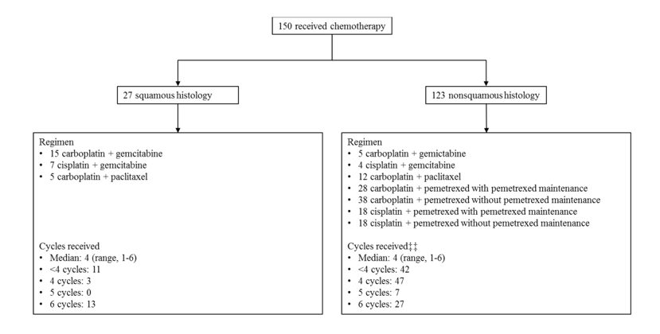
Notes:
the investigator’s choice of platinum-based chemotherapy regimens for 4 to 6 cycles: carboplatin plus pemetrexed, cisplatin plus pemetrexed, carboplatin plus gemcitabine, cisplatin plus gemcitabine, or carboplatin plus paclitaxel. Our patient had squamous histology so this is what her regimen would have been.

Slide 26
Inclusion Criteria
Age ≥18 years
ECOG PS 0-1
Histologically or cytologically confirmed stage IV NSCLC
PD-L1 expression ≥50%
Measurable disease by RECIST v1.1 criteria (Response Evaluation Criteria in Solid Tumors)
Life expectancy of greater than or equal to 3 months
Acceptable bone marrow, hepatic, and kidney function
Notes:
(Eastern Cooperative Oncology group performance-status, 5 point scale, 0 indicating no symptoms, higher scores worse disability)

Slide 27
Exclusion Criteria
Presence of a sensitizing EGFR mutation or ALK translocation
Receiving systemic glucocorticoids (excluding daily glucocorticoid-replacement therapy for conditions such as adrenal or pituitary insufficiency)
Receiving other immunosuppressive treatment
Untreated brain metastases
Active autoimmune disease for which they had received systemic treatment during the previous 2 years
Active interstitial lung disease
A history of pneumonitis for which they had received glucocorticoids
Notes:
(other targeted therapies for those EGFR and ALK mutations

Slide 28
Results

Slide 29
There were no significant differences in demographics and disease characteristics of patients in the intention-to-treat population.
Notes:
Figure 1- The demographic characteristics of the patients and the disease characteristics at baseline were generally well balanced between treatment groups (Table 1), although more patients in the chemotherapy group than in the pembrolizumab group had never smoked (12.6% vs. 3.2%) and more patients in the pembrolizumab group than in the chemotherapy group had brain metastases (11.7% vs. 6.6%). These differences were not statistically significant.

Slide 30
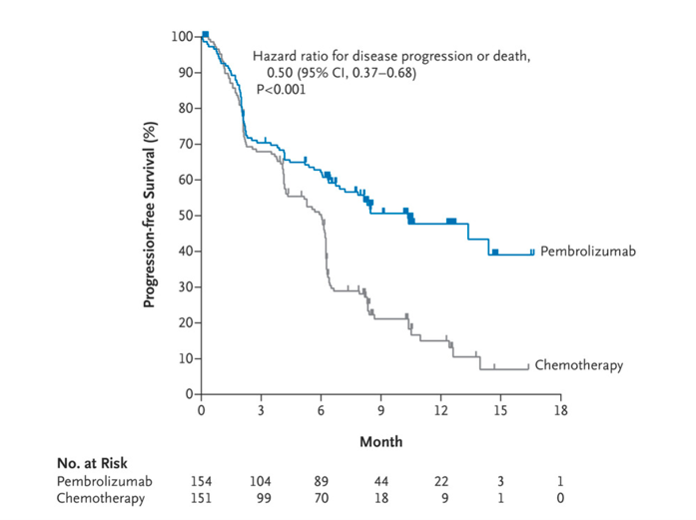
Median progression-free survival was longer in the pembrolizumab group.
Notes:
In the intention-to-treat population, on the basis of 189 total events of progression or death, median progression-free survival was 10.3 months (95% confidence interval [CI], 6.7 to not reached) in the pembrolizumab group and 6.0 months (95% CI, 4.2 to 6.2) in the chemotherapy group

Slide 31
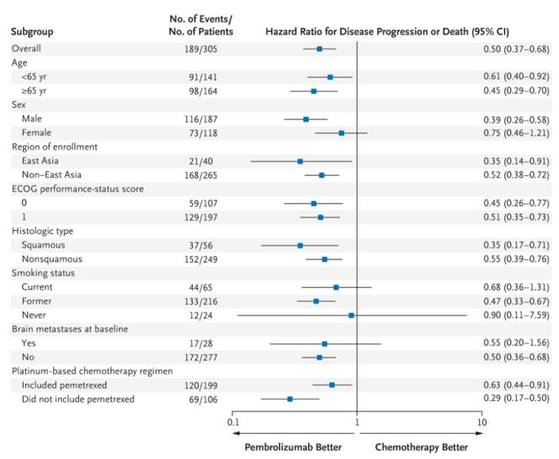
The benefit of pembrolizumab with respect to progression-free survival was evident in all subgroups examined.
Notes:
Panel B shows the analysis of progression-free survival in key subgroups.

Slide 32
Overall survival was significantly longer in the pembrolizumab group than in the chemotherapy group.
Notes:
At the time of the second interim analysis, 108 deaths had occurred. The estimated percentage of patients who were alive at 6 months was 80.2% (95% CI, 72.9 to 85.7) in the pembrolizumab group and 72.4% (95% CI, 64.5 to 78.9) in the chemotherapy group (Figure 2); median overall survival was not reached in either group. Overall survival was significantly longer in the pembrolizumab group than in the chemotherapy group (hazard ratio for death, 0.60; 95% CI, 0.41 to 0.89; P=0.005).

Slide 33
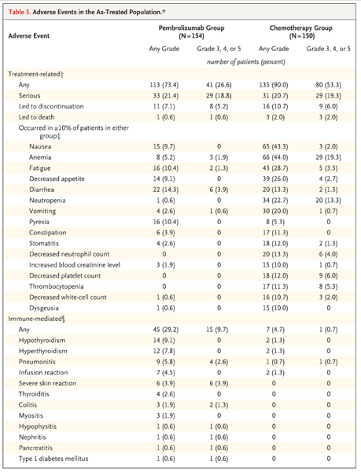
More treatment-related adverse events occurred in the chemotherapy group.
Notes:
During treatment with the initially assigned therapy, treatment-related adverse events occurred in 73.4% of the patients in the pembrolizumab group and in 90.0% of the patients in the chemotherapy group. The most common treatment-related adverse events were diarrhea (in 14.3% of the patients), fatigue (10.4%), and pyrexia (10.4%) in the pembrolizumab group and anemia (44.0%), nausea (43.3%), and fatigue (28.7%) in the chemotherapy group . Don’t mention p values but say its significant

Slide 34
External Validity and Application

Slide 35
Are these results generalizable?
Study Population
General NSCLC Patient Population
Median age ~65 years
ECOG PS 0-1
PD-L1 expression ≥50%
Average age of diagnosis: 70 years
Most people are diagnosed at later stage and tend to be treatment-naïve
PD-L1 expression higher than what most people have
Notes:
Population treatment naive and low ECOG
Not totally unrealistic to be treatment naive because it usually presents late stage anyway
Is it realistic to a study on stage 4 if most people are stage 2? Check epidemiology
In practice if it’s greater than one percent, they try the checkpoint inhibitors

Slide 36
Do the results apply to our patient?
Study Population
Our Patient
~65 years old
ECOG PS 0-1
Stage 4 NSCLC
PD-L1 expression ≥50%
Treatment naïve
No untreated brain mets
67 years old
ECOG 1
Stage 4 NSCLC
PD-L1 expression greater than 1% but less than 50%
Chemically treatment naïve, but brain radiation first
Still a candidate for pembrolizumab!
Notes:
She had an ECOG of x, PDL1 greater than 1% but not greater than 50%, 67 years old (median age is 64 in pembrolizumab group). Both our patient and the general pop tend to have lower PD-L1 expression. Ongoing phase 3 studies, such as KEYNOTE-042 (ClinicalTrials.gov number, NCT02220894), will assess the benefit of pembrolizumab over chemotherapy in previously untreated patients who have a tumor proportion score of 1% or greater.

Slide 37
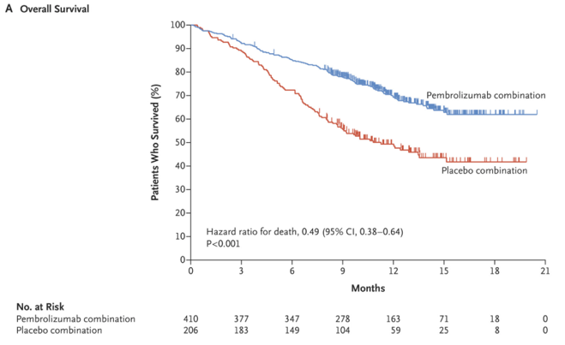
Very recent trial showed that the addition of pembrolizumab to standard chemotherapy resulted in significantly longer overall and progression-free survival than chemotherapy alone.
Notes:
Came out in April 16, 2018.
Median progression-free survival was 8.8 months (95% CI, 7.6 to 9.2) in the pembrolizumab-combination group and 4.9 months (95% CI, 4.7 to 5.5) in the placebo-combination group (hazard ratio for di

Slide 38
Summary

Slide 39
Take-Home Points
Pembroluzimab was associated with:
Longer progression-free survival
Longer overall survival
Fewer treatment-related adverse events than platinum-based chemotherapy
Pembroluzimab is a great option for treating patients with NSCLC, particularly highly PD-L1-expressing tumors
Ongoing studies to evaluate efficacy in patients with tumors with less PD-L1 expression and to evaluate efficacy of pembroluzimab in addition to chemotherapy
Notes:
In conclusion, the results of the KEYNOTE-024 trial showed that pembrolizumab was associated with longer progression-free and overall survival and fewer treatment-related adverse events than was platinum-based combination chemotherapy in patients with previously untreated advanced NSCLC and a PD-L1 tumor proportion score of 50% or greater.

Slide 40
Thank you! Questions?

