Slide 1
ANITA Trial
Ariel pollock
Sinai journal club
6/1/17

Slide 2
Case
HPI:
69 yo male, former 50 pack year smoker, who had a 5cm RLL mass incidentally seen on CXR during a workup for inguinal hernia repair, now s/p RMLobectomy. He feels well and denies any cough, SOB, hemoptysis, anorexia, unintentional weight loss, fever/chills.
ROS: all negative
PMH: Afib, CD, BPH, OSA, HTN
PSH: None
Allergies: NKDA
Meds:Ticagrelor, Atorvastatin, Tylenol, Metoprolol, Tumsulosin
FHx: Noncontributory
SHx: Former smoker, 50 pack years
Notes:
Alexander cohen

Slide 3
Case
Physical Exam: BP 119/72, HR 65, T 97.9, RR 18, Wt 208lb, SpO2 96%
General: Lively, appears stated age
HEENT: No LAD
Cardio: RRR, normal S1/S2
Pulm: CTAB, symmetric chest wall motion, no rales, rhonchi or wheezes
Pathology: RML and margin, Level 7 LN
AdenoCA, 7.0cm, does not invade visceral pleura. +LVSI
N1 LN+
PDL1 0%; EGFR exon 20 insertion
Imaging: (prior to surgery)
PET/CT: RML mass 5cm, SUV 10.5. No definite hilar, axillary, mediastinal LAD

Slide 4
pico
Population: Patients with stage IB – IIIA NSCLC
Intervention: Adjuvant Chemotherapy
Control: No Adjuvant Chemotherapy
Outcome: Overall survival
Does adjuvant chemotherapy improve overall survival in patients with stage IB-IIIA NSCLC?

Slide 5
NSCLC Staging
AJCC 7th Edition Stage Grouping
Stage IA | T1a – 1b | N0 | M0
Stage IB | T2a | N0 | M0
Stage IIA | T1a – T2a | N1 | M0
 | T2b | N0 | M0
Stage IIB | T2b | N0 | M0
 | T3 | N0 | M0
Stage IIIA | T1a – T2b | N2 | M0
 | T3 | N1 – N2 | M0
 | T4 | N0 – N1 | M0
Stage IIIB | T4 | N2 | M0
 | Any T | N3 | M0
Stage IV | Any T | Any N | M1a – M1b
AJCC 4th Edition Stage Grouping
Stage I | T1 – T2 | N0 | M0
Stage II | T1 – T2 | N1 | M0
Stage IIIA | T1 – T2 | N2 | M0
 | T3 | N0 – N2 | N0
Stage IIIB | Any T | N3 | M0
 | T4 | Any N | M0
Stage IV | Any T | Any N | M1
Notes:
T1 – 3cm or less
T2 - >3cm or involving main bronchus, or atelectasis
T3 – any size invading chest wall, diaphragm, pleura
T4 – invading mediastinum, heart, great vessels, trachesa, esophagus, vertebral body, or malignant pelural effusion
T1a – 2cm or less
T1b between 2-3cm
T2 is less than 7cm
T3 is greater than 7cm
T4 same invasion as other place. But mpleural effusion makes it M1a

Slide 6
Management of Early – locally advanced stage
Accounts for ~30% of lung cancer cases
Stages IA – IIIA (this study excluded stage IB)
Surgical resection was mainstay of treatment
What about adjuvant therapies?
5 year Overall Survival
Stage IA | 78%
Stage IB | 58%
Stage IIA | 46%
Stage IIB | 36%
Stage IIIA | 24%

Slide 7
Postoperative Therapies
Adjuvant therapy = therapy (either chemotherapy or radiation therapy) after surgical intervention
Meta-analysis in 1998 showed that post-operative RT was detrimental to patients with completely resected tumors
Early studies did not show a benefit from adjuvant chemotherapy, thus it was not routinely used
BUT

Slide 8
Adjuvant Chemo
Meta-analysis in 1995 of all trials of adjuvant chemotherapy vs BSC (best supportive care) demonstrated 13% risk reduction of death with adjuvant chemotherapy (cisplatin-based) and absolute survival benefit of 4% at 5yrs
But, this did not impact clinical practice because of heterogeneity of the studies included, non-significance, and lack of RCT
The results prompted 8 different studies, including the ANITA trial

Slide 9
ANITA – Pragmatic Study Design
Multicenter, multinational, randomized open control trial
After surgery, patients received either chemotherapy (cisplatin + vinorelbine) or were observed
PORT was left to decision of participating centers, but decided before patients were included in the trial
Randomization and statistical analysis performed by Biometric Department of the IRPF
Treatment allocation was not masked
What are potential problems with an open trial?

Slide 10
Eligibility
Inclusion
Stage IB – IIIA (pathologic staging)
R0 resection
Age 18-75
WHO performance status 2 or less
Adequate biological functions
Exclusion
Concurrent malignant disease
Previous primary tumors

Slide 11
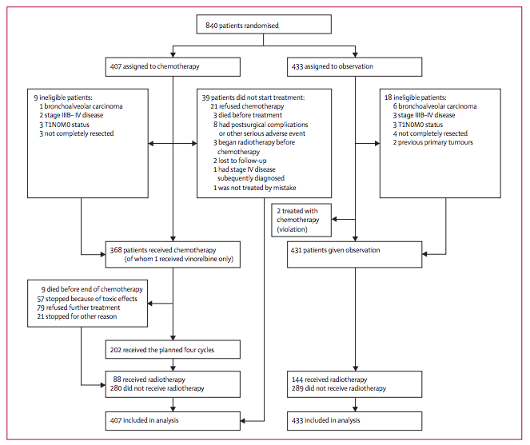
Consort Diagram
Intention to treat analysis

Slide 12
Outcome Measures
Primary Endpoint
Overall survival
Measured as time from date of randomization to death from any cause, or to last follow-up
Secondary Endpoints
Disease-free survival
Safety

Slide 13
Power of the study
Assumed a 2yr survival of 30% in the control group and a 10% improvement in the chemotherapy group
Required a sample size of 400 patients per treatment group for 90% power
Power maintained by the ITT analysis
Subgroup analyses were not planned

Slide 14
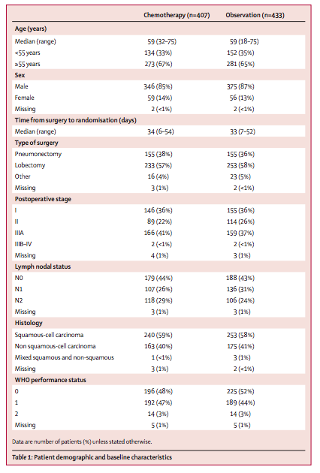
Table 1
No difference between two groups
Biological variables, medical and surgical history, tobacco, EtOH, clinical characteristics did not differ at baseline
Chemotherapy n=407
Observation n=433

Slide 15
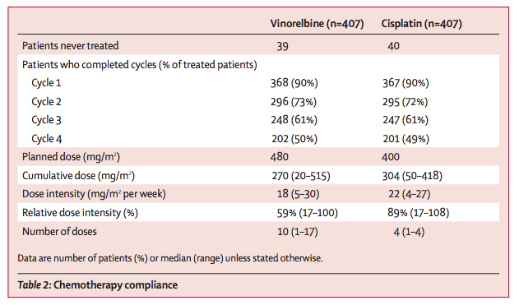
Table 2

Slide 16
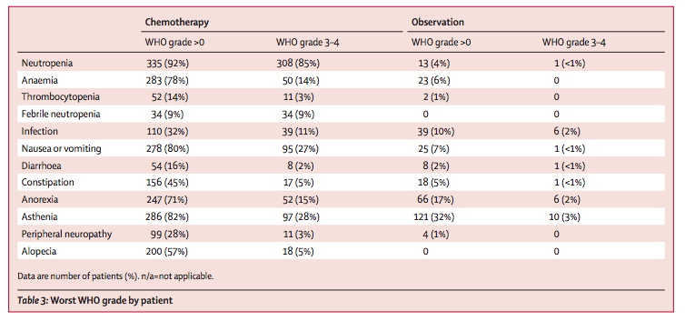
Table 3

Slide 17
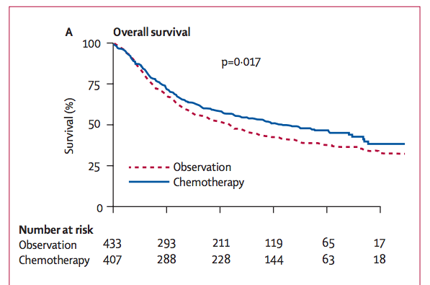
Figure 2
Median Survival
Chemotherapy - 65.7 months
Observation – 43.7 months
HR 0.80 [0.66-0.96]
Absolute OS benefit: 2.8% at 1yr
4.7% at 2 yrs
8.6% at 5yrs
8.4% at 7 yrs

Slide 18
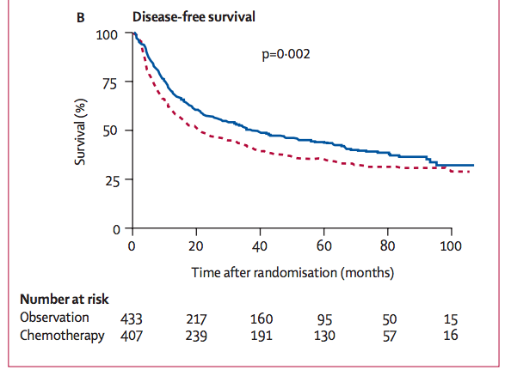
Figure 2
Median DFS
Chemotherapy – 36.3 months
Observation – 20.7 months
HR 0.76 [0.64-0.91]
Absolute benefit: 9% at 6 months
9.5% at 1yr
9.6% at 2yrs
8.7% at 5 yrs
5.5% at 7rs

Slide 19
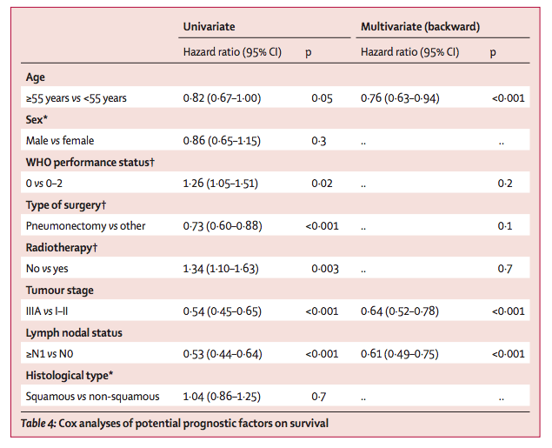
Table 4

Slide 20
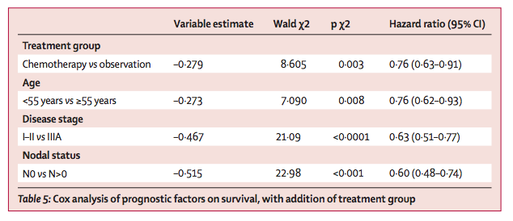
Table 5

Slide 21
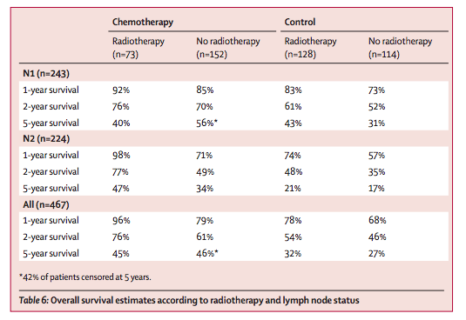
Table 6

Slide 22
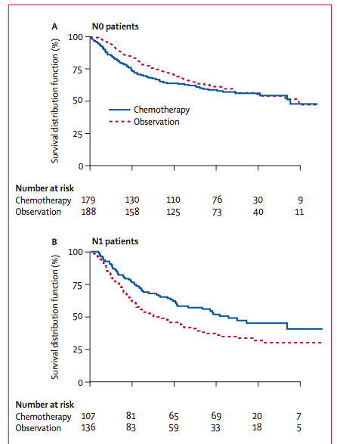
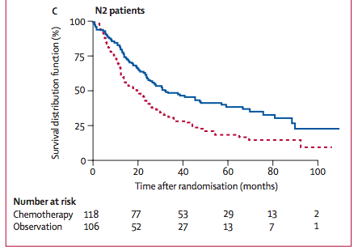
Figure 3
5yr survival
58% chemo
61% observation
5yr survival
40% chemo
19% observation
5yr survival
52% chemo
36% observation

Slide 23
Subgroup Analysis
Evaluation of treatment effects for a specific end point in subgroups of patients defined by baseline characteristics
Example: OS for each individual stage
Usually to answer: Do the treatment effects vary among levels of a baseline factor?
Does adjuvant chemotherapy affect survival more in patients with Stage II vs III, etc?
ANITA Trial - benefit is seen in patients with stage II and IIIA disease
5yr OS | Chemo | Control | HR
Stage IB | 62% | 64% | 1.10 (0.76-1.57)
Stage II | 52% | 39% | 0.71 (0.49-1.03)
Stage IIIA | 42% | 26% | 0.69 (0.53-0.9)
p=0.07

Slide 24
Test of Interaction
Heterogeneity of treatment – do treatment effects vary across the levels of the baseline characteristic?
Assessed with a statistical test for interaction
Quantitative interaction – magnitude of effect of B depends on value of A, but direction of effect of B is constant for all A
Qualitative interaction – both magnitude and direction of each variable’s effect depends on other variable
Often calculated with regression model
Trials often lack power to detect heterogeneity in treatment effect
ANITA Trial – heterogeneous effect of chemotherapy according to nodal status (p=0.004), but sample sizes were small

Slide 25
Limitations to these analysis
With multiple subgroup analysis, there can be false positive findings
Post hoc analyses are less valuable than pre-specified subgroup analyses

Slide 26
Internal Validity
Patients randomized, although researchers not blinded
Baseline characteristics similar between two groups
ITT analysis
Receipt of radiation therapy was not controlled

Slide 27
External Validity
ITT analysis
Noncompliance and drop-outs
Radiation therapy left up to discretion of individual institutions

Slide 28
Summary
Prior to the ANITA trial and other trials that were established around the same time, there was no role for adjuvant chemotherapy in the management of early stage/locally advanced NSCLC
ANITA demonstrated a significant survival benefit in patients who received chemotherapy rather than best supportive care
The benefit was largely seen in stages II-IIIA, although they were not powered to directly look at these groups
The LACE meta-analysis combined the 5 largest RCTs to show the benefit in stages II-IIIA

Slide 29
Our patient
69 yo male, former 50 pack year smoker, who had a 5cm RLL mass incidentally seen on CXR during a workup for inguinal hernia repair, now s/p RMLobectomy.
Do we give him adjuvant chemotherapy?

Slide 30
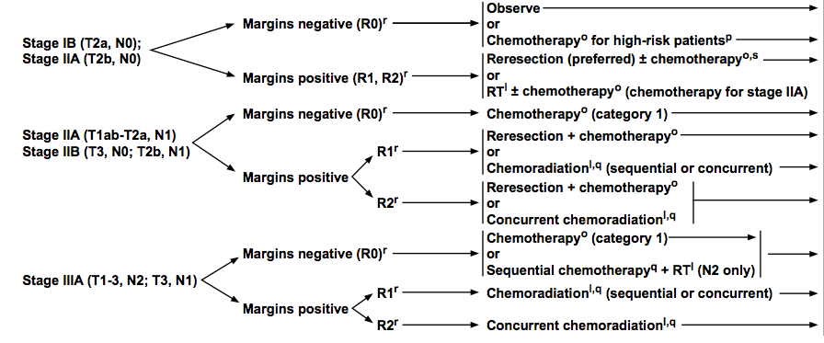
Current NSCLC Management

