Slide 1
COURAGE
By Sukrit Narula

Slide 2
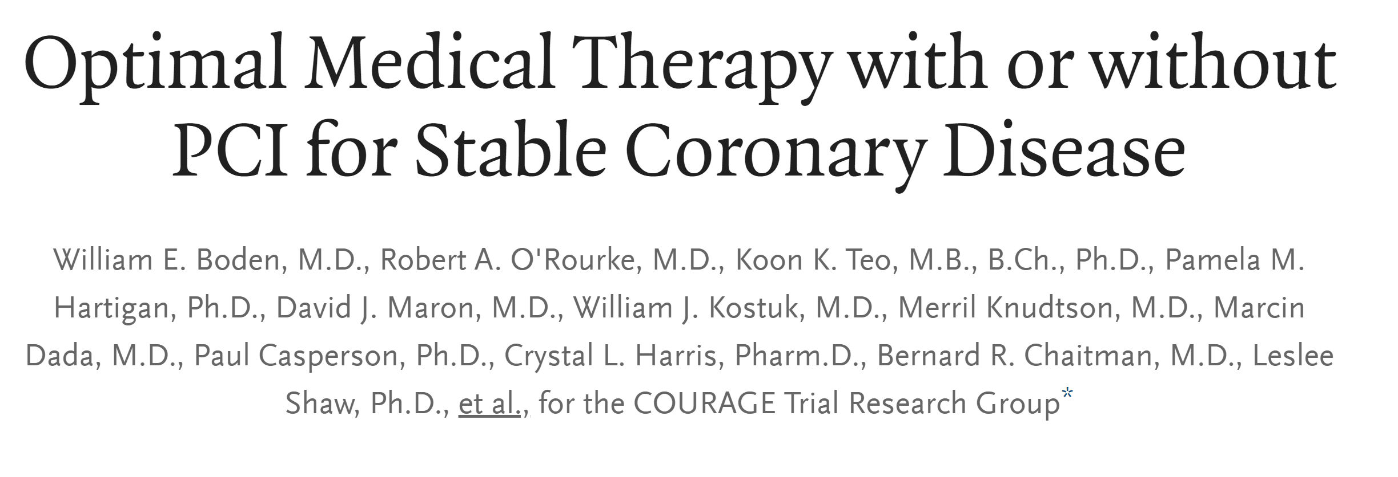

Slide 3
Clinical Outcomes Utilizing Revascularization and Aggressive Drug Evaluation

Slide 4
Clinical Outcomes Utilizing Revascularization and Ag(?)gressive Drug Evaluation

Slide 5
Ischemic Heart Disease
Stable CAD
Acute Coronary Syndrome
Unstable Angina
STEMI
NSTEMI

Slide 6
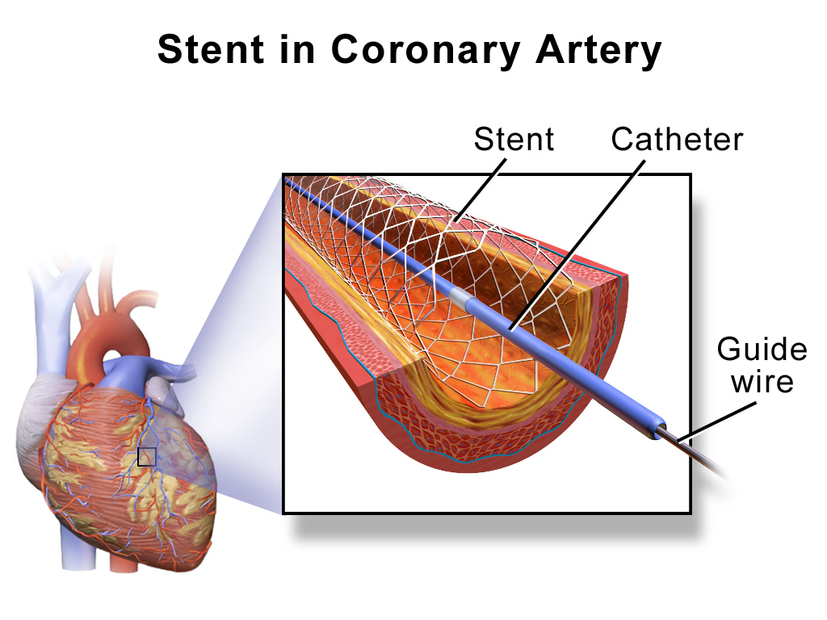
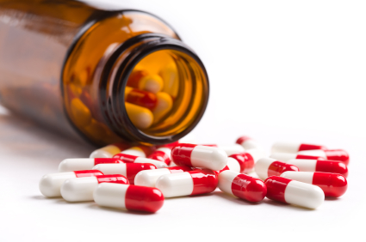

In patients with STABLE coronary artery disease (CAD), what treatment should I pursue initially?

Slide 7
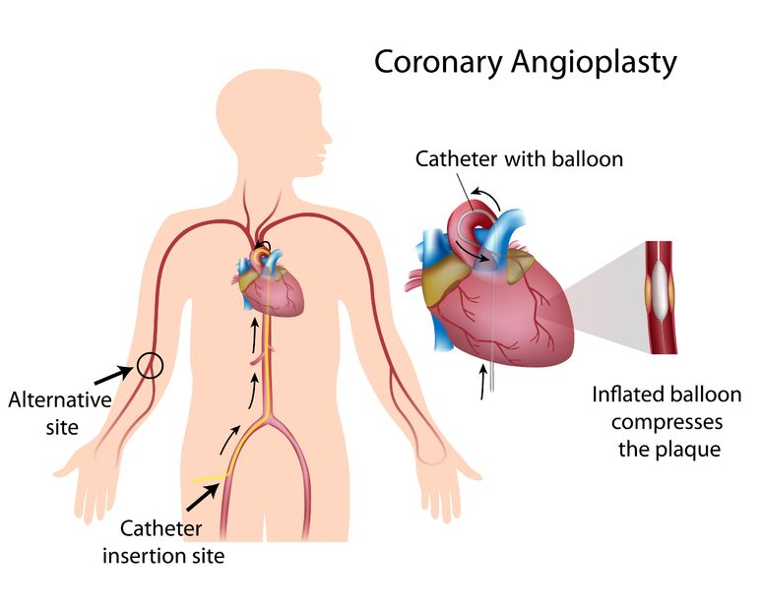
What is percutaneous coronary intervention?
Source: http://www.secondscount.org/treatments/treatments-detail-2/wrist-groin-risks-benefits-of-femoral-versus-trans#.Wqhag-jwbD4
Notes:
A thin tube (catheter) is threaded through a vessel and a stent is placed and opened so that blood flow can continue through an atherosclerotic valve

Slide 8
Oculo-Stenotic Reflex
You see stenosis, you stent it
For the purpose of patient outcomes…
It’s not that simple

Slide 9
What is optimal medical therapy in stable CAD?
ß-blockers (e.g. metoprolol, bisoprolol, atenolol)
Calcium channel blockers (verapamil, diltiazem)
Nitrates
Antiplatelet therapy (aspirin and/or clopidogrel)
Statin therapy

Slide 10
Background - COURAGE
1 million stents performed in year 2004 (American Heart Association Statistics Committee and Stroke Statistics Subcommittee)
New York State Angioplasty Registry (2004): 85% were elective (done in patients with stable CAD)
ACS evidence favors revascularization. At the time of this trial (2007), stable CAD uncertain (although it still is uncertain to date)

Slide 11
COURAGE design
50 Centers in US and Canada
Open-label (as opposed to single blind or double blind trial)
Parallel-group (as opposed to crossover)
Randomized controlled trial (random allocation to treatment/intervention group)
Enrollment period from 6/1999 to 1/2004
Primary outcome: Composite of death from any cause and nonfatal MI
Median follow-up: 4.6 years
Analysis: Intention-to-treat
N=2,287 people
Percutaneous Coronary Intervention plus Optimal Medical Therapy: 1,149 people
Optimal Medical Therapy alone: 1,138 people

Slide 12
Composite Outcome
What is a composite outcome?
Combine outcomes so that if one component occurs, the whole composite occurs
Example:
Composite | Death | Non-fatal MI | Non-fatal stroke
Yes | Yes | No | No
Yes | No | Yes | No
Yes | No | No | Yes
No | No | No | No

Slide 13
Composite Outcome
Why do it?
Sample size. If you have a higher event rate, your sample size does not need to be as large to show a difference.
Follow-up concerns. You are not waiting around for rare events to happen.
Assumption #1: avoiding any one outcome is as desirable as avoiding another
Assumption #2: Impact of intervention should be equitable on each component of the composite in order for interpretation to be meaningful
Assumption #3: Does each individual endpoint within the composite occur with similar frequency?
*credit to Terry Shaneyfelt MD at UAB for examples in slides 14-16

Slide 14
Example of Bad Composite
In 1999, there was an RCT done on corticosteroids as a treatment for COPD exacerbation. This was their composite outcome:
Death
Need for intubation
Administration of steroids
NEJM!
Assumption #1: avoiding any one outcome is as desirable as avoiding another
Assumption #2: Impact of intervention should be equitable on each component of the composite in order for interpretation to be meaningful i.e. relative risk reductions should be similar
Assumption #3: Does each individual endpoint within the composite occur with similar frequency?

Slide 15
TIME Trial
End Point | Invasive | Medical
Composite End Point | 39 | 95
Death | 17 | 12
Non-fatal MI | 14 | 20
Admission for ACS | 28 | 106
Assumption #1: avoiding any one outcome is as desirable as avoiding another
Assumption #2: Impact of intervention should be equitable on each component of the composite in order for interpretation to be meaningful i.e. relative risk reductions should be similar
Assumption #3: Does each individual endpoint within the composite occur with similar frequency?

Slide 16
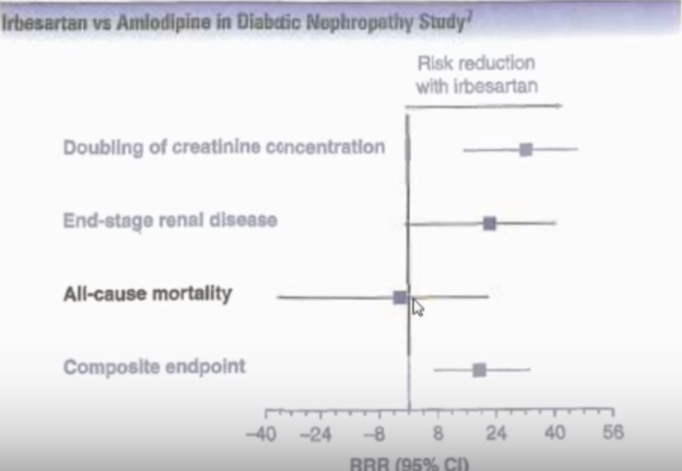
Assumption #1: avoiding any one outcome is as desirable as avoiding another
Assumption #2: Impact of intervention should be equitable on each component of the composite in order for interpretation to be meaningful i.e. relative risk reductions should be similar
Assumption #3: Does each individual endpoint within the composite occur with similar frequency?

Slide 17
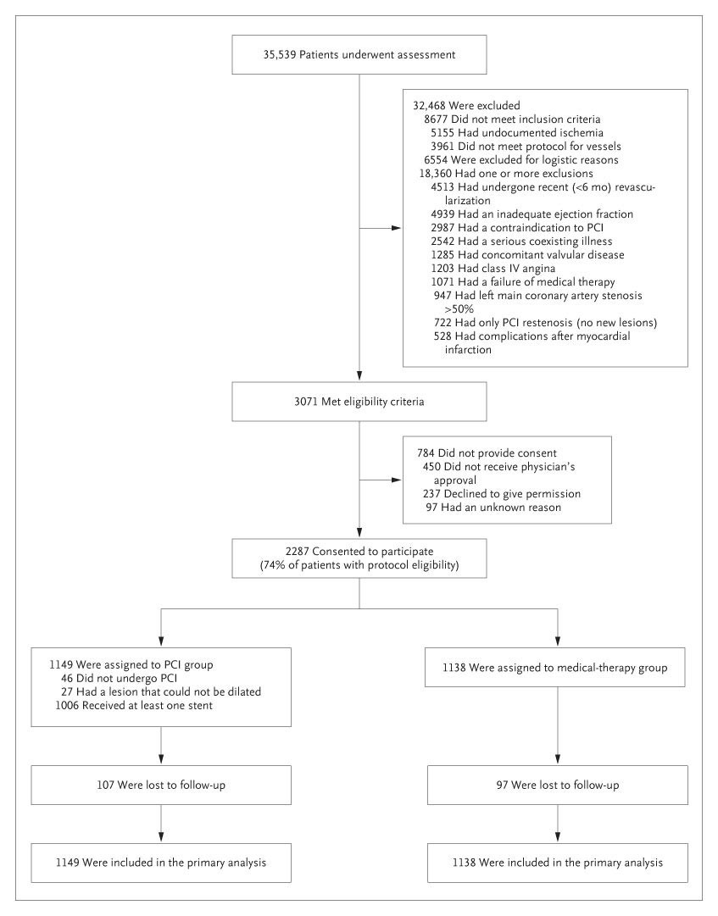

Slide 19
COURAGE inclusion criteria
Stable CAD
Canadian Cardiovascular Society (CCS) class I, II, III or stabilized class IV angina
At least 70% stenosis in at least one coronary artery
Objective myocardial ischemia, with any of:
Substantial changes in ST segment depression
T wave inversion on the resting EKG
Inducible ischemia with either exercise or pharmacologic stress test
80% stenosis with classic angina without provocative testing
Notes:
Classic angina – symtpoms assoc w/activity and relievd by stopping activity and/or nitroglycerin

Slide 20
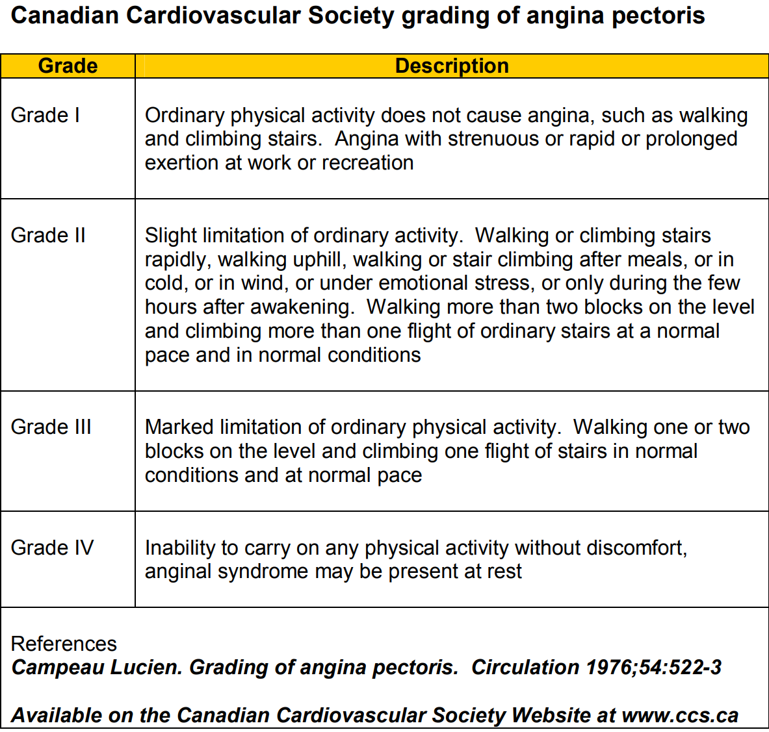

Slide 21
Courage exclusion criteria
Persistent CCS class IV angina
Markedly positive treadmill test (significant ST segment depressions and/or hypotensive response during stage I of Bruce protocol)
LVEF <30%
Refractory CHF
Cardiogenic shock
≥50% left main disease
Revascularization within the previous 6 months
Coronary lesions deemed unsuitable for PCI

Slide 22
COURAGE Baseline Characteristics
All comparisons are in the format PCI group vs. OMT only group
Age: 61.5 vs. 61.8
Sex: 85% male vs. 85% male
Race: 86% white vs. 86% white
5% black vs 5% black
6% Hispanic vs. 5% Hispanic
3% ‘other’ vs 4% ‘other’

Slide 23
COURAGE Baseline Characteristics
All comparisons are in the format PCI group vs. OMT only group
Past Medical History
Diabetes: 32% vs 35%
Hypertension: 66% vs 67%
Congestive Heart Failure: 5% vs 4%
Cerebrovascular Disease: 9% vs 9%
Myocardial Infarction: 38% vs 39%
Previous PCI: 15% vs 16%
Coronary Artery Bypass Graft: 11% vs 11%
Stress Test
Total: 85% vs 86%
Treadmill: 57% vs 57% (duration in both groups = 7 minutes)
Pharmacological stress test: 43% vs 43%
Nuclear Imaging
Single Reversible Defect: 22% vs 23%
Multiple Reversible Defect: 65% vs 68%
Angina class:
Class 0: 12% vs 13%
Class I: 30% vs 30%
Class II: 36% vs 37%
Class III: 23% vs 19%

Slide 24
COURAGE Baseline Characteristics
All comparisons are in the format PCI group vs. OMT only group
Ejection Fraction: 61% vs 61%
Disease in Graft: 62% vs 69%
One Vessel Disease: 31% vs 30%
Two Vessel Disease: 39% vs 39%
Three Vessel Disease: 30% vs 31%
Proximal LAD Disease: 31% vs 37% (p-value = 0.01) (worth noting)

Slide 25
COURAGE control group
The control group received:
Anti-ischemic: metoprolol, amlodipine, Isosorbide mononitrate
Antiplatelet: aspirin 81-325mg. Otherwise clopidogrel 75mg daily
BP control: Lisinopril or losartan
Niacin and/or fibrates with goal HDL >40 mg/dl and TG <150 mg/dl
Lipid control: Statins ± ezetimibe with goal of LDL 60-85 mg/dl
Exercise therapy recommended

Slide 26
COURAGE treatment group
The treatment group received:
Anti-ischemic: metoprolol, amlodipine, Isosorbide mononitrate
Antiplatelet: aspirin 81-325mg AND clopidogrel 75mg daily (why)
BP control: Lisinopril or losartan
Niacin and/or fibrates with goal HDL >40 mg/dl and TG <150 mg/dl
Lipid control: Statins ± ezetimibe with goal of LDL 60-85 mg/dl
Exercise therapy recommended
PCI:
Clinical success of the PCI = procedural PCI success w/out in-hospital MI, emergent CABG, death
Procedural PCI success = normal coronary flow and <50% stenosis after balloon angioplasty and <20% after stent by visual interpretation on angiographic study
Every investigator tried to revascularize target lesion. Complete revascularization done at the discretion of the attending.

Slide 27
Metric | PCI + OMT | OMT alone | Comparison
All cause mortality and nonfatal MI | 19% | 18.5% | HR 1.05 (95% CI: 0.87 -1.27, p = 0.62)
Death, nonfatal MI, nonfatal stroke | 20% | 19.5% | HR 1.05 (95% CI: 0.87-1.27, p = 0.62)
Death | 7.6% | 8.3% | HR 0.87 (95% CI: 0.65 – 1.16, p = NS)
Nonfatal MI | 13.2% | 12.3% | HR 1.13 (95% CI: 0.89-1.43, p = 0.33)
Nonfatal stroke | 2.1% | 1.8% | HR 1.56 (95% CI: 0.80-3.04, p = 0.19)
ACS hospitalization | 12.4% | 11.8% | HR 1.07 (95% CI: 0.84-1.37, p = 0.56)
Revascularization | 21.1% | 32.6% | HR 0.60 (95% CI: 0.51-0.71, p < 0.001)
CABG | 6.7% | 7.2%

Slide 28
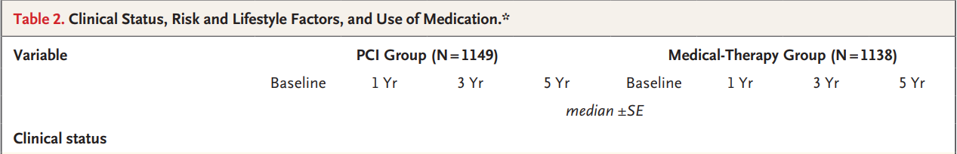

Slide 29
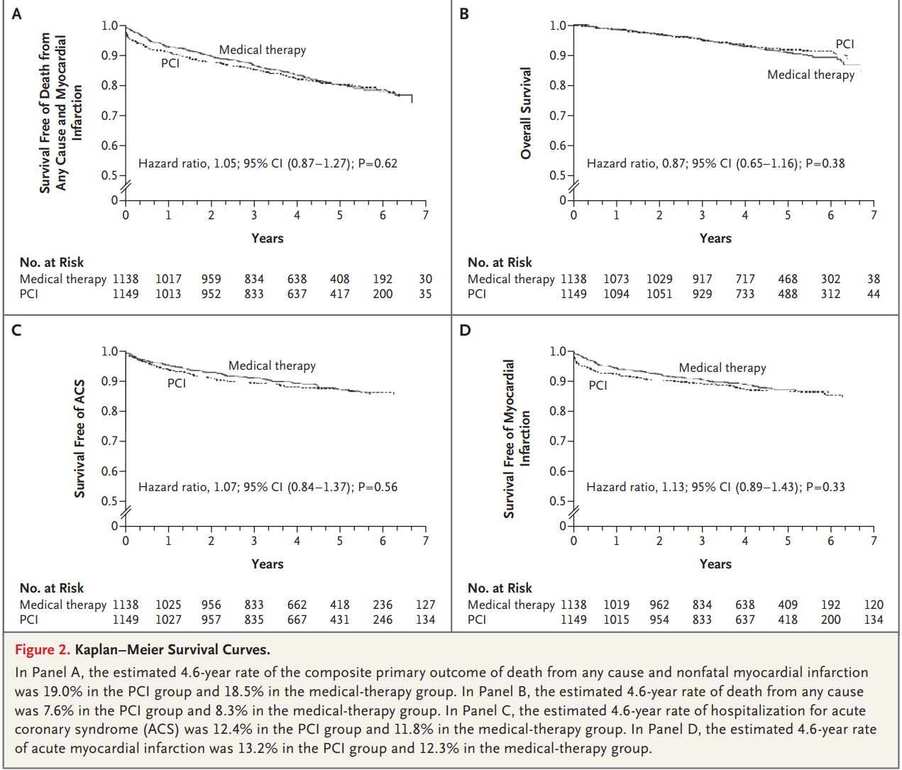

Slide 30
COURAGE Criticisms
Many Males, Many Whites
No FFR guidance (not their fault!)
Many patients excluded
Bare metal stents, not DES
How many stents

Slide 31
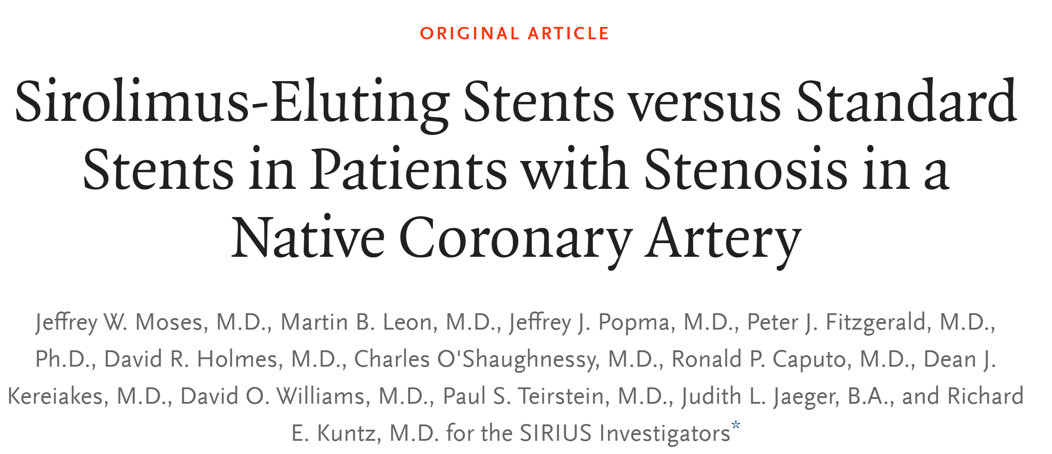

Slide 32
COURAGE Criticisms
Many Males, Many Whites
No FFR guidance (not their fault!)
Many patients excluded
Bare metal stents, not DES (paclitaxel, sirolimus)
How many stents

Slide 33
2007
COURAGE
2009
FAME
2011
STICH
2012
FAME-II
2017
ORBITA
BARI-2D

Slide 34
FAME-I Briefly
FFR guided PCI reduces composite outcome (death, nonfatal MI, and repeat revascularization) at one year compared to PCI alone in patients with multi-vessel CAD.

Slide 35
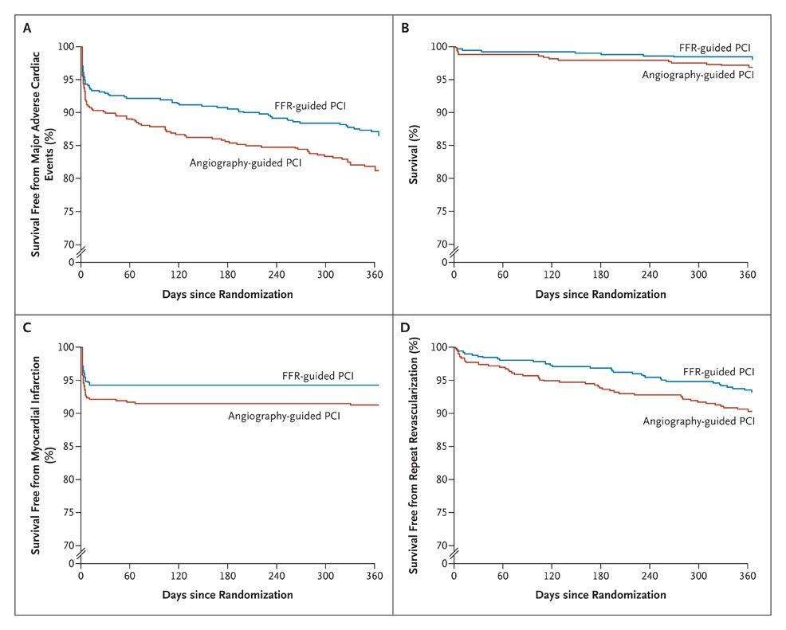
FAME-I Briefly

Slide 36
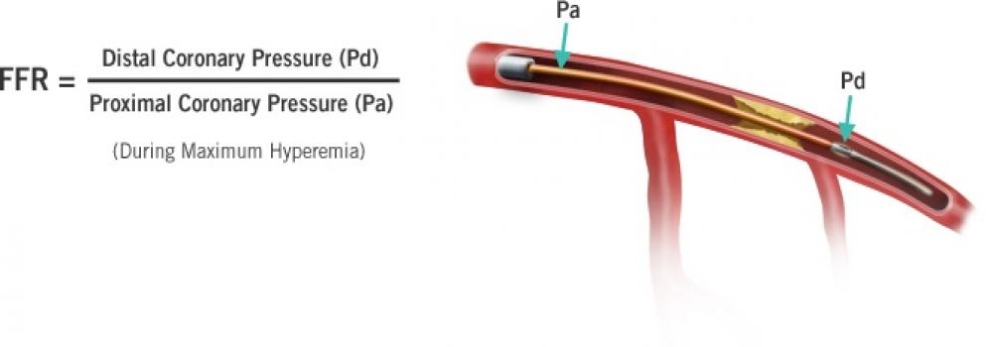
FFR
Source: https://www.radcliffecardiology.com/intervention/fractional-flow-reserve-ffr-0

Slide 37
FAME-II Briefly
PCI reduces composite outcome (death, nonfatal MI, urgent revascularization) compared to OMT alone when FFR ≤0.80 in stable CAD. Results driven primarily by reduction in need for urgent revascularization.

Slide 38
ORBITA Briefly
PCI does not improve angina (measured by treadmill exercise time) compared to sham procedure. Both arms received anti-anginal therapy. PCI did not improve angina (assessed through standard questionnaires) or quality of life.
Notes:
6 week follow up
Compliance
Angina disproof

Slide 39
COURAGE Guidelines
ACC/AHA 2011:
Unless there is a clear indication for PCI or CABG, use FFR guidance to determine PCI vs. OMT

Slide 40
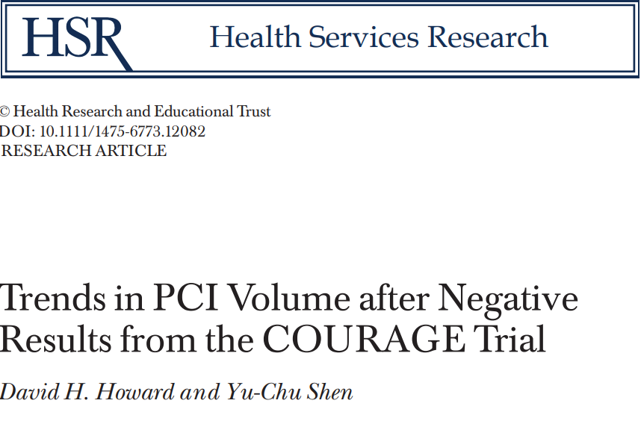
“The number of PCIs in patients without a diagnosis of AMI or unstable angina in Florida, Maryland, and New Jersey declined from 48,000 in 2006 to 40,000 in 2008 (17 percent). There was no change in the number of PCIs in patients with a diagnosis of AMI. We observed similar patterns in U.S. community hospitals. PCI volume did not decline in England.”

