Slide 1
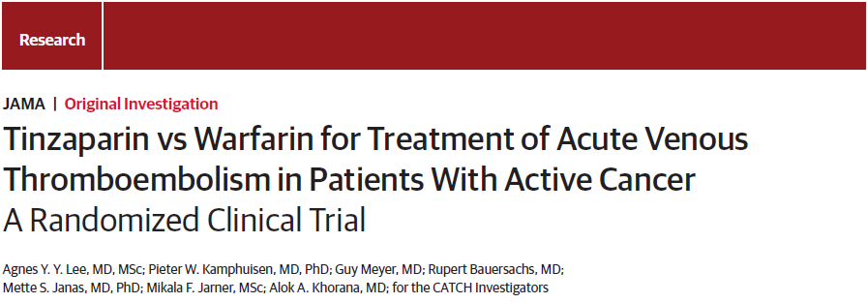
JAMA, August 18, 2015
John Power, MS4
1/15/18

Slide 2
Comparison of Acute Treatments in Cancer Hemostasis Trial

Slide 3

Comparison of Acute Treatments in Cancer Haemostasis
= CATCH Trial

Slide 4
Case
HPI: MM is a 48 year old male with a history of ulcerative colitis and colorectal cancer complicated by metastases to the liver and lung with recurring post-obstructive pneumonia. MM presents to outpatient chemotherapy infusion center for his 6th cycle of chemotherapy but is complaining of an exacerbation of his baseline shortness of breath since waking up. Patient denies cough, fever, sick contacts.
Notes:
So this is a very sick patient with a wide differential

Slide 5
Case
Vitals:
  T: 99.7
  HR: 106
  BP: 130/88
  RR: 24
  SpO2: 92% on room air
PE:
  HEENT: 3cm JVD
  Pulmonary: increased work of breathing, lungs clear to auscultation bilaterally
  Cardiac: tachycardia with regular rhythm
  Extremities: 2+ pitting edema to the right knee
Notes:
JVD wnl
Cardio pulmonary exam largely benign
BUT unilateral lower extremity edema

Slide 6
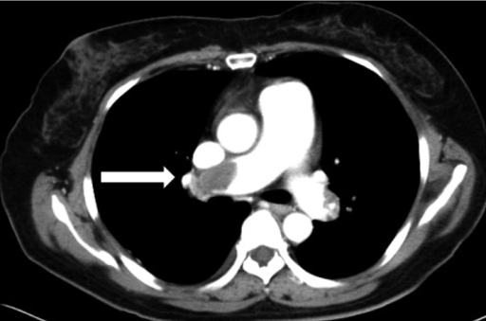
Case
Notes:
CT angiogram: large pulmonary embolism

Slide 7
Clinical Question
In patients with cancer, is Low-Molecular-Weight Heparin more effective and/or safer than Warfarin in preventing recurrent venous thromboembolism (VTE)?
PICO
Population: Adults receiving cancer care, with recent cancer diagnosis, and/or with metastatic cancer
Intervention: Low-Molecular-Weight Heparin
Control: Warfarin
Outcome:
  Efficacy: Recurrent Venous Thromboembolism
  Safety: Bleeding Events
Notes:
Our population is a broad cancer

Slide 8
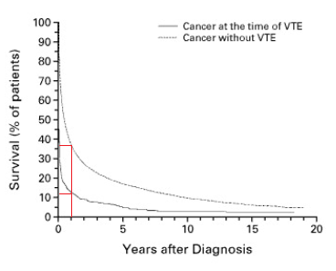
Background: VTE in Cancer
Deep vein thrombosis and Pulmonary embolism (VTE) are seen in up to 10% of patients with cancer¹
Cancer causes a hypercoagulable state which puts patients at a higher risk for developing VTE
36%
12%
This hypercoagulable effect is different across various cancers and cancer treatments
VTE is associated with a worse prognosis for patients with cancer²
Anticoagulation to prevent VTE is only recommended after a VTE event has occurred
Timp et al. Epidemiology of cancer-associated venous thrombosis. Blood. 2013 Sep 5;122(10):1712-23.
Sørensen et al. Prognosis of cancers associated with venous thromboembolism. N Engl J Med. 2000 Dec 21;343(25):1846-50.
Notes:
Chemo increases thrombosis risk, some more than others
Some cancers are more thrombogenic than others

Slide 9
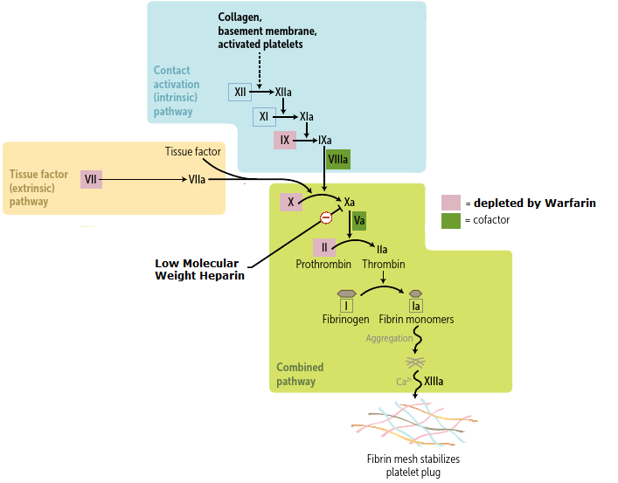
Background: VTE Treatment
Warfarin
Daily oral pill
Acts at liver to inhibit clotting factor production
Days until effect
Requires frequent INR monitoring
Many drug-drug interactions
Therapeutic levels harder to achieve in cancer patients
Low-Molecular-Weight Heparin
Daily subcutaneous injections
Acts directly in the bloodstream
Immediate effect
No monitoring required
Le, Tao. First Aid for the USMLE Step 1 2014. McGraw-Hill Medical, 2014.
Notes:
Talk here about the reasons we can think of why warfarin is inferior: relies on oral intake, intact GI system, functioning liver… and INR is harder to maintain in therapeutic window in cancer patients
Mention cyp-450

Slide 10
Background: Literature
CLOT Trial (NEJM, 2003) ¹: Multicenter, open-label, Randomized Control Trial (RCT) (n=676)
  6 month trial duration
  Recurrent VTE was less common in patients receiving LMWH compared to Warfarin (HR = 0.48)
  No significant difference in bleeding events or mortality
  Patients overwhelmingly from N America, W Europe
Lee AY et al. Low-molecular-weight heparin versus a coumarin for the prevention of recurrent venous thromboembolism in patients with cancer. N Engl J Med. 2003 Jul 10;349(2):146-53.
Notes:
The largest, most comprehensive trial before CATCH

Slide 11
Background: Literature
LITE Trial (Am J Med, 2006)¹: Multicenter, open-label, RCT (n=200)
  12 month trial duration
  Recurrent VTE was less common in patients receiving LMWH compared to Warfarin (RR = 0.44)
  No significant difference in bleeding events or mortality
Hull RD et al. Long-term low-molecular-weight heparin versus usual care in proximal-vein thrombosis patients with cancer. Am J Med. 2006 Dec;119(12):1062-72.
Notes:
Smaller trial (n=200)

Slide 12
Background: Literature
Cochran Review (2011):¹ Metanalysis of 7 RCTs
  VTE was less likely in patients receiving LMWH compared to those receiving Warfarin (HR 0.47) (moderate quality evidence)
  No significant difference in bleeding events or mortality (low quality evidence)
Akl EA et al. Anticoagulation for the long-term treatment of venous thromboembolism in patients with cancer. Cochrane Database Syst Rev. 2011 Jun 15;(6):CD006650.

Slide 13
Background: Guidelines
Warfarin, LMWH, and DOACs are all equally recommended for VTE prevention in the general population
At time of CATCH’s publication, LMWH was recommended as the treatment of choice for VTE prevention in cancer patients¹
However, Warfarin was frequently used worldwide in cancer patients for VTE prevention due to cost considerations
Lyman GH et al. Venous thromboembolism prophylaxis and treatment in patients with cancer: american society of clinical oncology clinical practice guideline update 2014. J Clin Oncol. 2015 Feb 20;33(6):654-6.

Slide 14
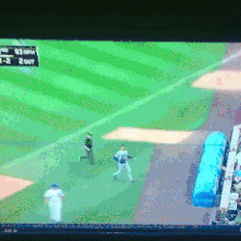
We’re ready for CATCH!

Slide 15
Design (1/2)
Population: 900 patients in 164 centers across 32 countries
  Powered to demonstrate superiority of LMWH over Warfarin
Analysis:
  Prospective study
  Intention-to-Treat Analysis (prespecified per-protocol analysis also conducted for efficacy analysis)

Slide 16
Design (2/2)
Randomization:
  Concealed computer-generated randomization schedule
  Randomization stratified by tumor extent, geographic region, and history of VTE
Blinding:
  “Open label”
  Patient and providers not blinded (PROBE design)
  Blinded central adjudication committee

Slide 17
Prospective randomized open blinded end-point (PROBE) vs Double-Blinded Design
Pro’s
Con’s
Lower cost since interventions aren’t masked
Easier to conduct than a double-blind study → can take place in less academic settings → more applicable
Similar strength to a double-blinded trial in terms of randomization, end-point evaluation by a blinded adjudication committee
Potential investigator bias since intervention is known
Differences in interventions can drive preferential compliance by patients

Slide 18
Why did CATCH use PROBE instead of double-blinding?
“to avoid sham INR testing and sham injections, which increase patient anxiety.”
“Providing realistic sham INR values is particularly challenging in an oncology population”
“Blinding might also compromise patient safety during episodes of thrombocytopenia and invasive procedures, and assessment of quality of life.”
Notes:
To me, these claims seem less likely than 1) their aim to conduct this study across a wide spectrum of centers 2) financial considerations

Slide 19
Inclusion Criteria
Age ≥ 18
Diagnosis of active cancer
  Confirmed via histology or cytology
  Diagnosed or treated within the last 6 months OR advanced disease
Acute symptomatic VTE confirmed via standard imaging modalities
Able to perform self-care and remain ambulatory at least 50% of waking hours (ECOG ≤ 2)
Notes:
CKD stage 4-5 = at or nearing dialysis requirement

Slide 20
Exclusion Criteria
Severe Chronic Kidney Disease (CLCr ≤ 20)
Contraindication to Anticoagulation
Known hypersensitivity to LMWH or Warfarin
History of Heparin-Induced Thrombocytopenia
Already on anticoagulation for >72 hours before randomization
Was on anticoagulation at time of initial VTE
Life expectancy < 6 months
Unlikely to comply with study protocol
On another trial
Women of childbearing potential / fertile men not using effective contraception
Notes:
Give explanations for each one

Slide 21
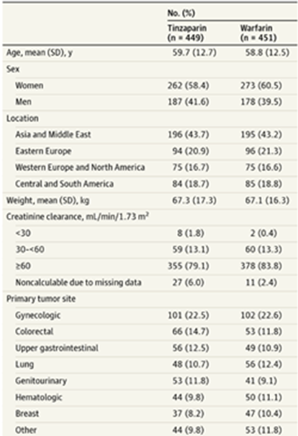

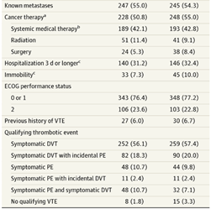
Table 1: Baseline Characteristics
Notes:
Generally well-matched
No race/ethnicity but location is a decent surrogate
First box: look at how multinational this population is
Second box: Are these patients as sick as the cancer patients you see in MSH?

Slide 22
Study Treatments
LMWH Group
Warfarin Group
Subcutaneous LMWH (tinzaparin) injections once daily for 6 months at fixed dose
Median treatment duration=168/180d
86% received an injection for ≥75% of treatment days
Oral Warfarin pill for 6 months following standard protocol:
Patients also received LMWH for the first 5-10 days until Warfarin was therapeutic (INR>2.0)
Dose adjusting every 2 weeks based off INR
Median treatment duration=127/180d
Mean time in INR therapeutic range = 47.0%
Temporary interruption of ≤ 3 weeks allowed for bleeding events, invasive procedures, or low platelet count
Notes:
Mean time in INR therapeutic range is similar to that of other studies in cancer patients
Heparain at Fixed dose bc it would be a simpler regimen. Also based off a smaller trial showing fixed dose led to less VTE w no safety concerns in cancer population

Slide 23
Endpoints: Same as CLOT Trial
Efficacy
Safety
Primary: Composite of symptomatic DVT + symptomatic nonfatal PE + fatal PE + incidental DVT + incidental PE
Secondary: each of the above outcomes separately (the study wasn’t powered for secondary endpoints so these are meant to be hypothesis generating only)
Major bleeding (fatal, in critical organ, drop in hemoglobin by ≥2 g/dL, or led to transfusion of ≥2 units of blood)
Clinically relevant nonmajor bleeding (non-major but required medical or surgical intervention)
All-cause mortality
Notes:
This study set a high bar for what was considered a major bleed.

Slide 24
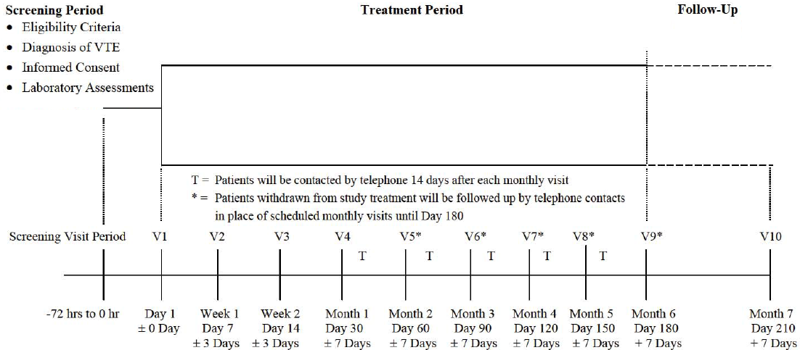
Event Monitoring
Notes:
Treatment period: monitoring for all endpoints including death and recurrent VTE
Follow-up: monitoring for safety outcomes + serious adverse events

Slide 25
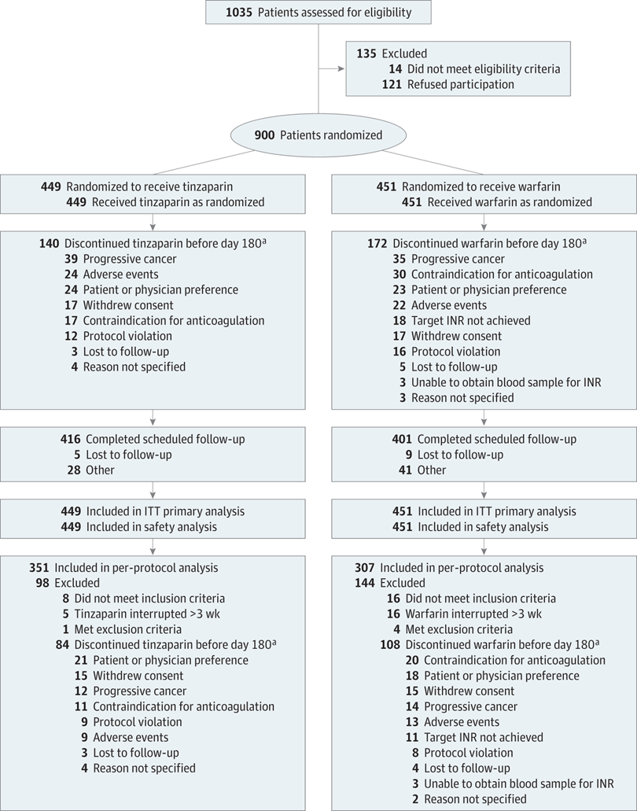
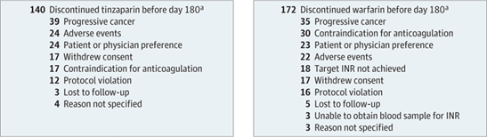
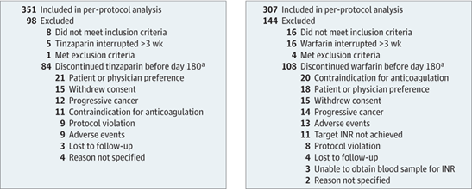
Consort Diagram
Notes:
30 had contraindication to anticoagulation in warfarin group vs 17 in heparin
Warfarin group had 18 people d/c due to trouble achieving therapeutic INR

Slide 26
Results

Slide 27
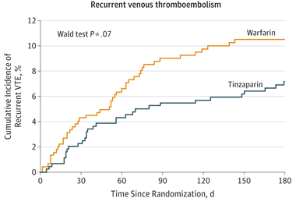
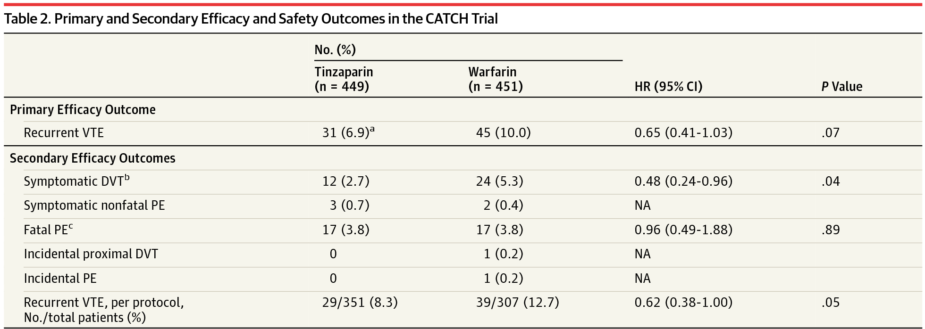
Notes:
There is a trend towards fewer recurrent VTE events but this was not statistically significant
The statistical significance of secondary efficacy outcomes is not conclusive, merely hypothesis generating

Slide 28
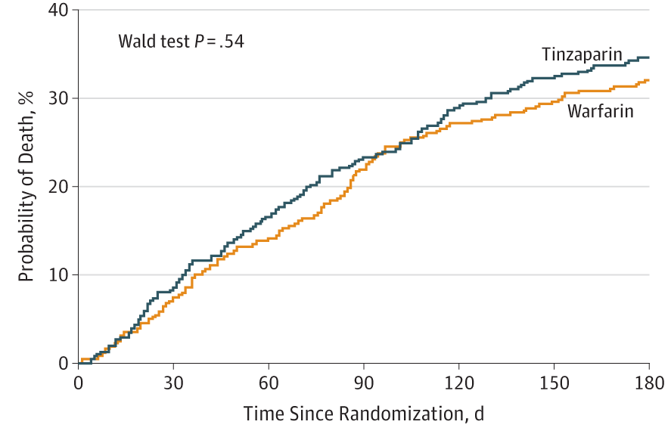
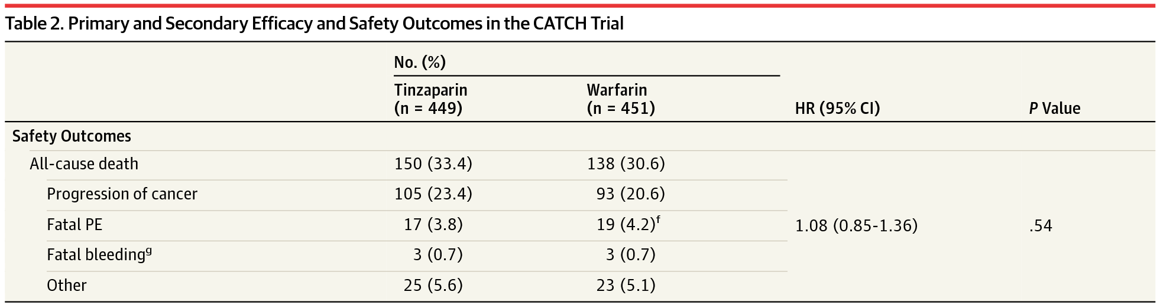
Mortality

Slide 29
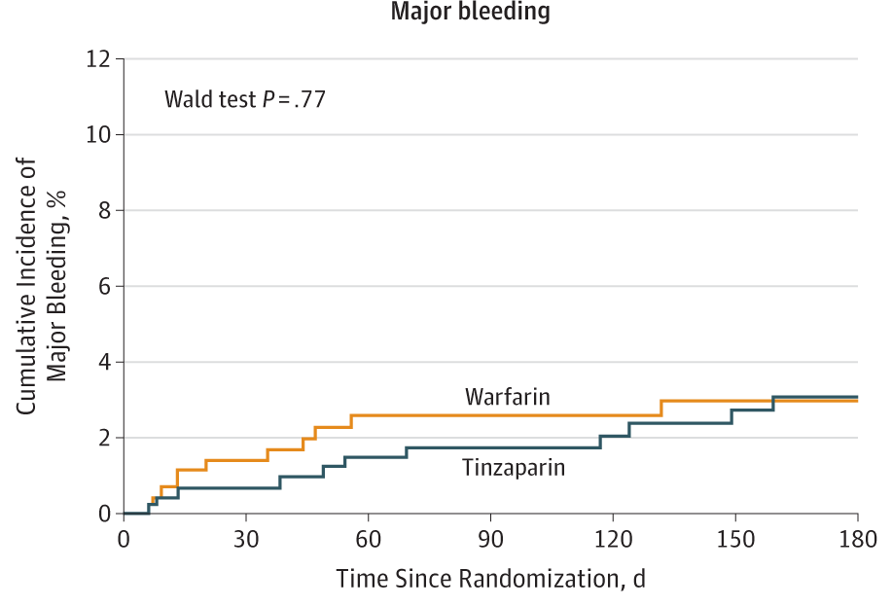
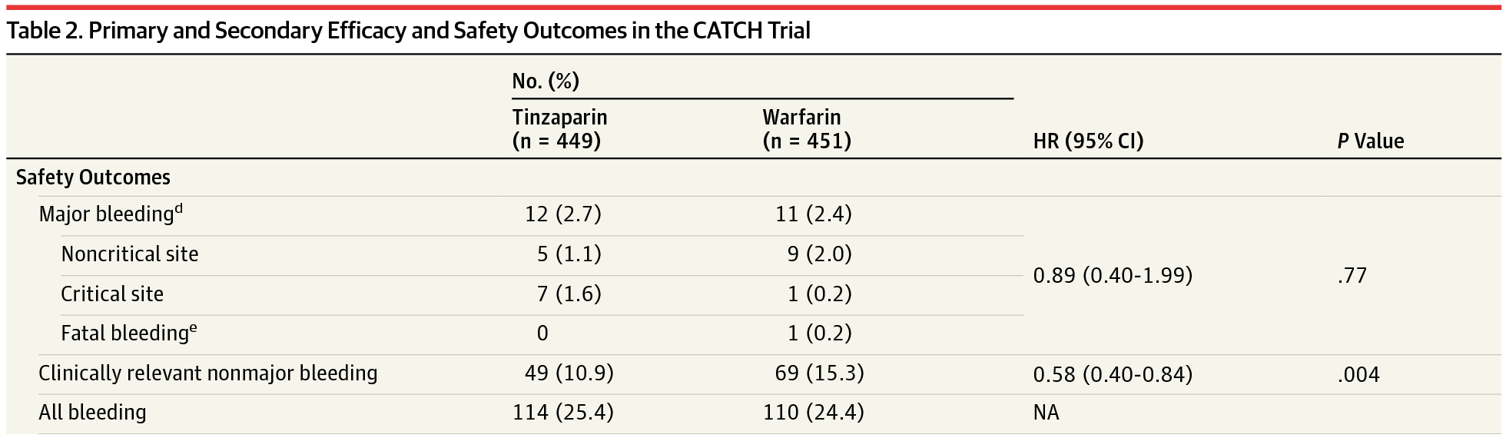
Number needed to treat = 1 / Absolute Risk Reduction
= 1 / (Control Event Rate – Experimental Event Rate)
= 1 / (15.3% – 10.9%)
= 1 / (4.4%)
Number needed to treat = 22.7 patients

Slide 30

What does this all mean??

Slide 31
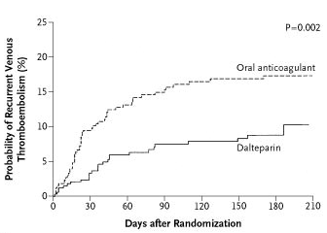
Why did CLOT find LMWH had superior VTE prevention while CATCH didn’t?
CLOT
CATCH
Warfarin
LMWH

Slide 32
CLOT’s Population Had Higher VTE Risk
 | CATCH Trial | CLOT Trial
% of time Warfarin group had therapeutic INR | 46% | 47%
Metastatic disease | 55% | 67%
Performance status=2 (instead of less severe 0,1) | 23% | 36%
Receiving anticancer therapy | 53% | 78%
Previous history of thrombosis | 6% | 11%
6-month mortality | 32% | 39%
 | CATCH Trial | CLOT Trial
6-month VTE cumulative recurrence in Warfarin group | 10.5% | 17.0%
6-month VTE cumulative recurrence in LMWH group | 7.2% | 9.0%
Notes:
Chemo is thrombogenic, pts getting chemo are at much higher risk

Slide 33
CATCH Predicted More VTE Than Was Actually Seen
CATCH was powered for a sicker population than the study enrolled
CATCH didn’t have enough patients & VTE events to show that LMWH was superior
 | Predicted | Actual
6-month cumulative VTE recurrence in Warfarin group | 12.6% | 10.5%
6-month VTE cumulative recurrence in LMWH group | 6.3% | 7.2%
Relative Risk Reduction | 50% | 31%
Relative Risk Reduction = 1 - (Experimental Event Rate / Control Event Rate) * 100
  = 1 - (7.2 / 10.5) * 100
  = 31%

Slide 34
External Validity (1/2)
Applicable to many settings: 164 centers in 32 countries
Wide distribution of cancer types
Revisiting key inclusion/exclusion criteria:
  Inclusion
    Able to perform self-care & remain ambulatory ≥ 50% of waking hours (ECOG ≤ 2)
  Exclusion
    Severe Chronic Kidney Disease (CLCr ≤ 20)
    Was on anticoagulation at time of initial VTE
    Life expectancy < 6 months

Slide 35
External Validity (2/2)
CATCH had a relatively low morbidity population in terms of metastasis, performance status, VTE history, and anticancer therapy
→ The findings of CATCH are more applicable to a cancer population with low morbidity

Slide 36
Our Patient
48 year old male with a history of ulcerative colitis and colorectal cancer complicated by metastases to liver and lung status post 5 cycles of chemotherapy with severely limited performance status presents with shortness of breath for the past 3 days, found on chest CT to have a segmental pulmonary embolism.
What does CATCH tell us about how to best treat this patient?
Notes:
High morbidity patient. Can extrapolate to say LMWH would be more effective and safer

Slide 37
Other scenarios:
66 year old female with insulin-dependent diabetes, end stage renal disease on dialysis, and breast cancer status post lumpectomy now presenting with shortness of breath and chest pain, found on chest CT to have pulmonary embolism and metastasis to the lungs
What does CATCH tell us about how to best treat this patient?
Notes:
Doesn’t apply because patient is ESRD so can’t give LMWH

Slide 38
Other scenarios:
36 year old female with 10 pack year smoking history, on oral contraceptive pills, with breast cancer status post lumpectomy three months ago now presenting with leg pain found to have DVT
What does CATCH tell us about how to best treat this patient?
Notes:
Low morbidity patient, fits CATCH population. LMWH might not be significantly more effective than Warfarin but can certainly say would be safer

Slide 39
Other scenarios:
72 year old male with hypertension, congestive heart failure, atrial fibrillation on warfarin, prostate adenosarcoma status post prostatectomy 2 months prior now presents with left lower extremity swelling and is found to have deep vein thrombosis
What does CATCH tell us about how to best treat this patient?
Notes:
Patient had VTE while on warfarin thus would be excluded from CATCH and would require more aggressive treatment

Slide 40
Summary
CATCH showed a trend towards superior efficacy of LMWH in preventing recurrent VTE but was not statistically significant
  But we extrapolate that a sicker population would have seen superiority of LMWH in preventing VTE
CATCH showed no difference in mortality or major bleeding
However, LMWH, resulted in fewer clinically relevant non-major bleeds when compared to Warfarin

Slide 41

That’s CATCH!

Slide 42
Special Thanks
Dr. Alexander Coltoff, PGY-2 Internal Medicine
Dr. Kevin Troy, Professor of Hematology and Medical Oncology
Sinai EBM Journal Club Leadership

