Slide 1
Introduction to
Evidence-Based Medicine
Andy Coyle, MD

Slide 2
Disclosures
I do not have conflicts of interest to disclose for this learning session.
I affirm that all discussions of drug use will be consistent with either FDA or compendia (i.e. medical textbook, published medical literature, professional society guidelines) approved indications

Slide 3
Objectives/Overview
By the end of the session, learners will:
Be able to list the steps in the Evidence-Based Medicine (EBM) cycle
Be able to describe potential issues with internal validity, study results, and generalizability (external validity)
Appreciate importance/relevance of EBM in clinical practice

Slide 4
My Goal Today:
To introduce a few key concepts in EBM and let you know when we’ll be exploring them further throughout the pre-clinical and clinical curriculum here at Sinai
Notes:
Rachel Pinotti
Manager, Information and Education Services
Levy Library

Slide 5
What You’ve Done So Far…
1st Year
Pubmed Module/Milestone (Fall)
InFocus1: Study Design (Sampling, Randomization, Introduction to Validity)
InFocus2: Hypothesis Testing, Statistical Inference, Correlation, Linear Regression
2nd Year
InFocus3: Advanced Study Design, Multivariate Analysis, Meta-Analysis, Survival Analysis
Notes:
Goal with this session is to begin the transition away from thinking about research creation and evaluation as a separate field, and to start to bring it to clinical care and the bedside. So question is how we take evidence that we see and apply it to our actual patients. Or even better, when we are seeing patients, how do we ask questions, acquire the right evidence, appraise the evidence, and if appropriate, apply it to our patients?
½ have had the ASM session on clinical guidelines and appraised a study on CT screening for lung cancer.

Slide 6
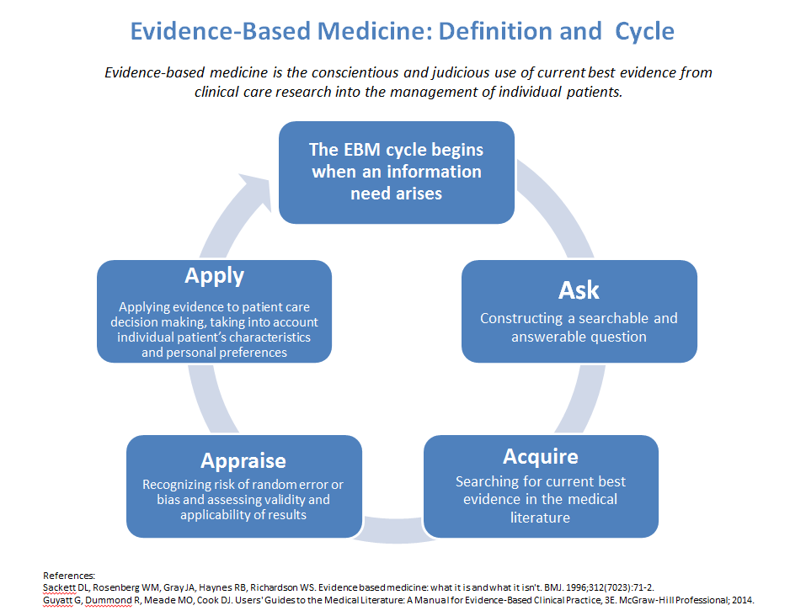
Notes:
This is the traditional EBM arc
Evidence-Based medicine was coined by Gordon Guyatt, a Canadian physician. Initially wanted to call it Scientific Medicine but colleagues were upset at the thought that they weren't be scientific.
Had module on searching pubmed as first-years
Will have session on Ask/Acquire in April as part of ASM
Read definition of EBM to group, comes from BMJ article which we’ll discuss more

Slide 7
Evidence-Based Medicine
Evidence based medicine is the conscientious, explicit, and judicious use of current best evidence in making decisions about the care of individual patients. The practice of evidence based medicine means integrating individual clinical expertise with the best available external clinical evidence from systematic research. By individual clinical expertise we mean the proficiency and judgment that individual clinicians acquire through clinical experience and clinical practice. Increased expertise is reflected in many ways, but especially in more effective and efficient diagnosis and in the more thoughtful identification and compassionate use of individual patients‘ predicaments, rights, and preferences in making clinical decisions about their care. By best available external clinical evidence we mean clinically relevant research, often from the basic sciences of medicine, but especially from patient centered clinical research into the accuracy and precision of diagnostic tests (including the clinical examination), the power of prognostic markers, and the efficacy and safety of therapeutic, rehabilitative, and preventive regimens.
Notes:
From its very inception, EBM was concerned about the fusion of evidence and clinical expertise to come up with treatment plans via shared-decision making with patients
Epistemologic Principles of Evidence-Based Medicine
The pursuit of truth is best accomplished by examining the totality of evidence, rather than by selecting a limited sample of evidence, which is at risk of being unrepresentative and will certainly be less precise than the totality.
Not all evidence is equal, and a set of principles can identify more vs less trustworthy evidence.
Evidence is necessary but not sufficient. Clinical decision making requires the application of values and preferences.

Slide 8
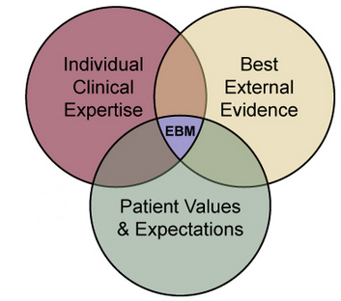
Evidence-Based Medicine
Notes:
EBM involves 3 fundamental principles:
First, optimal clinical decision making requires awareness of the best available evidence, which ideally will come from systematic summaries of that evidence.
Second, EBM provides guidance to decide whether evidence is more or less trustworthy—that is, how confident can we be of the properties of diagnostic tests, of our patients' prognosis or of the impact of our therapeutic options?
Third, evidence alone is never sufficient to make a clinical decision. Decision makers must always trade off the benefits and risks, and costs associated with alternative management strategies and, in doing so, consider their patients' unique predicament and values and preferences.

Slide 9
Why EBM? (Part 1)
Clinical Reasoning on the Wards // Developing and Maintaining Clinical Skills
Notes:
Remember hearing a talk about EBM as a student and thinking that this was irrelevant.]
The basis of good clinical decision-making is integrating evidence-based medicine with clinical expertise and the patient's values and preferences

Slide 10
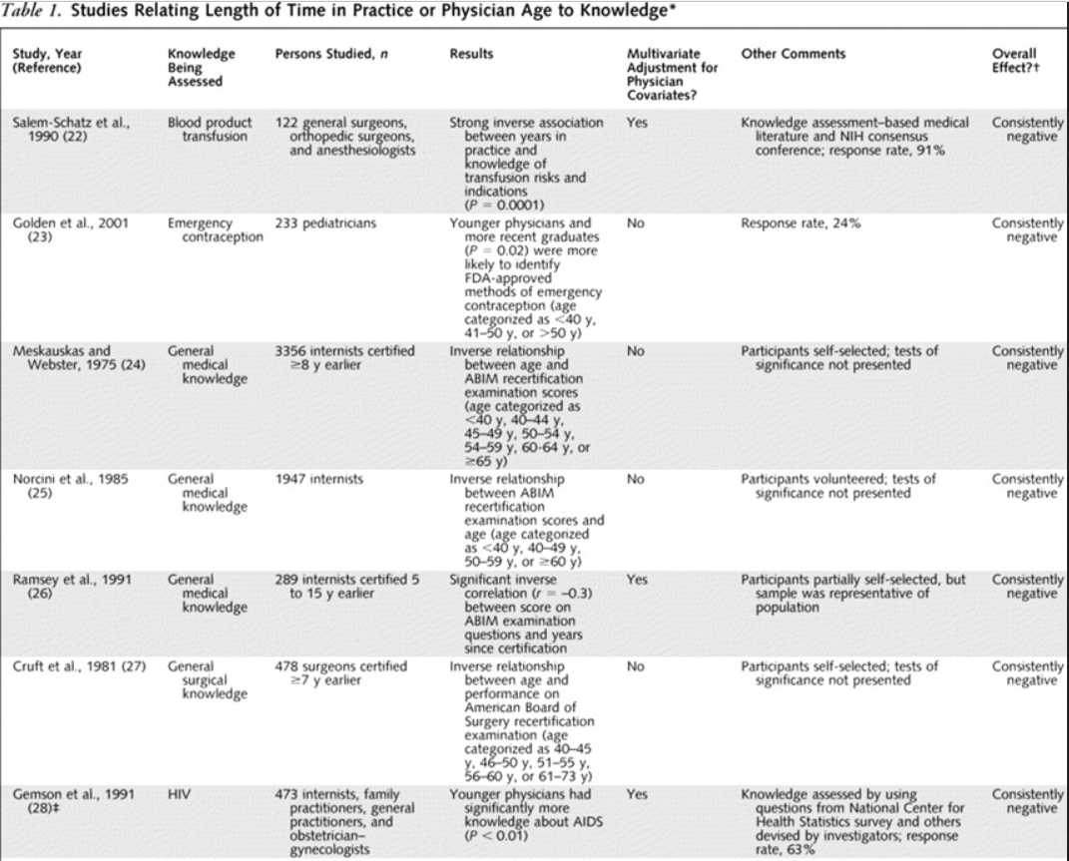
Notes:
http://annals.org/aim/article/718215/systematic-review-relationship-between-clinical-experience-quality-health-care

Slide 11
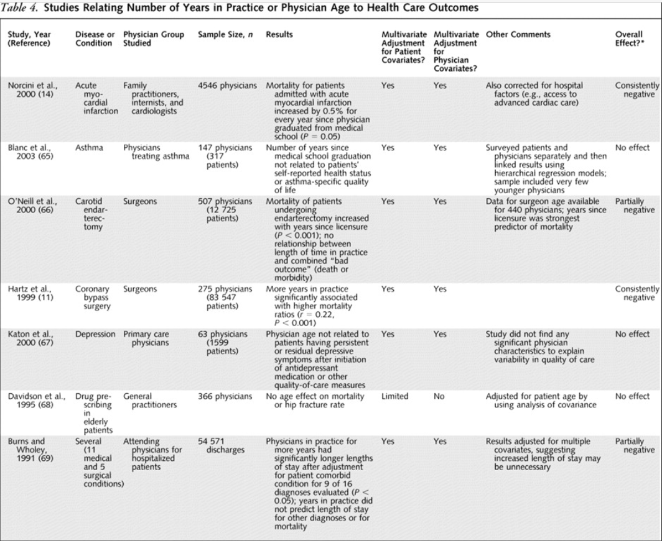
Notes:
High-risk patients with HF and cardiac arrest admitted to a teaching hospital during the dates of national cardiology conferences had lower 30-day mortality rates compared with patients admitted on other dates. Researchers also found that high-risk patients admitted for acute MI during a conference were less likely to undergo PCI, but no more likely to die than patients admitted when a conference was not scheduled.

Slide 12
Why EBM? (Part 1)
Clinical Reasoning on the Wards: Developing and Maintaining Clinical Skills
Translating Research into Clinical Skills

Slide 13
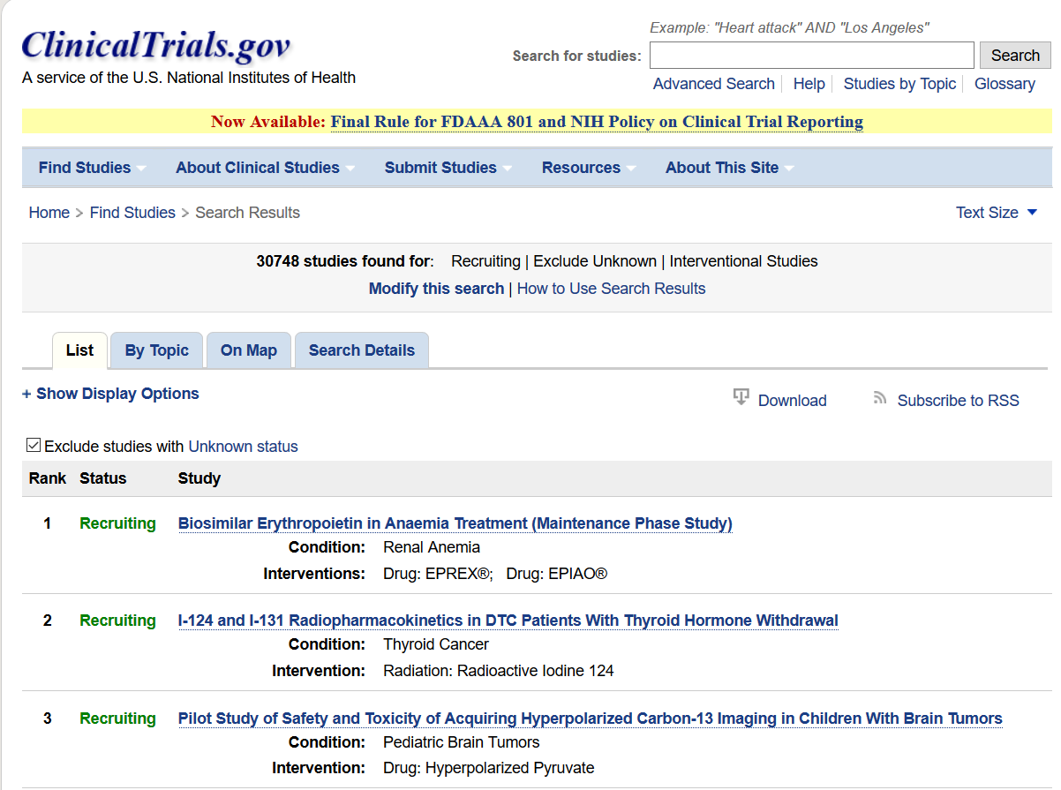
Notes:
101 studies for the medication ticagrelor alone

Slide 14
Why EBM? (Part 1)
Clinical Reasoning on the Wards: Developing and Maintaining Clinical Skills
Translating Research into Clinical Skills
Shared-Decision Making and Communication with Patients
Step 1!
Notes:
Biostatistics and Behavioral Sciences section of USMLE Step 1

Slide 15

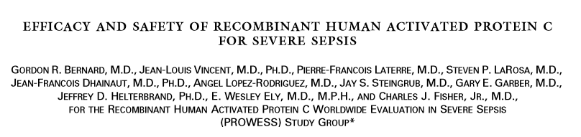
Why EBM? (Part 2)
Notes:
NEJM 2001
Recombinant Activated Protein C; anti-inflammatory therapy for severe sepsis
For patients with severe infections, the common end pathway is sepsis, the inflammatory response to infection that can ultimately prove fatal. Septic shock is where the patient’s require medication support to maintain normal blood pressures and carries a 50% mortality.

Slide 16
Why EBM? (Part 2)
Antithrombin III: JAMA 2001
Tifacogin (recombinant tissue factor pathway inhibitor): OPTIMIST Trial
Eritoran (MD2-TLR4 antagonist): ACCESS
Fludrocortisone: COIITTS Trial

Slide 17
Why EBM? (Part 2)
Notes:
NEJM 2001
Recombinant Activated Protein C; anti-inflammatory therapy for severe sepsis
For patients with severe infections, the common end pathway is sepsis, the inflammatory response to infection that can ultimately prove fatal. Septic shock is where the patient’s require medication support to maintain normal blood pressures and carries a 50% mortality.

Slide 18
Why EBM? (Part 2)
Relative Risk Reduction: 19.4%
Absolute Risk Reduction: 6.1% (P 0.005)
Why did no one prescribe Xigris?
1 2 3
Notes:
> 1.5 million cases of sepsis per year in US each year

Slide 19
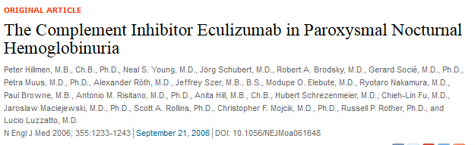
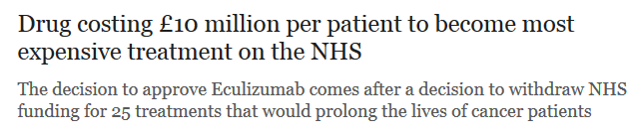
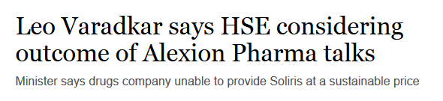
Cost?
Eculizumab reduces transfusion requirements, rates of red cell hemolysis, episodes of thrombosis, and improves quality-of-life. No effect on mortality.
Cost is ~ $20,000 per dose.
Dose given via injection every 2 weeks
Annual cost: ~ $500,000 per patient
Lifetime cost: ~ $5,000,000 per patient
Back
Notes:
NHS = UK
HSE = Ireland

Slide 20
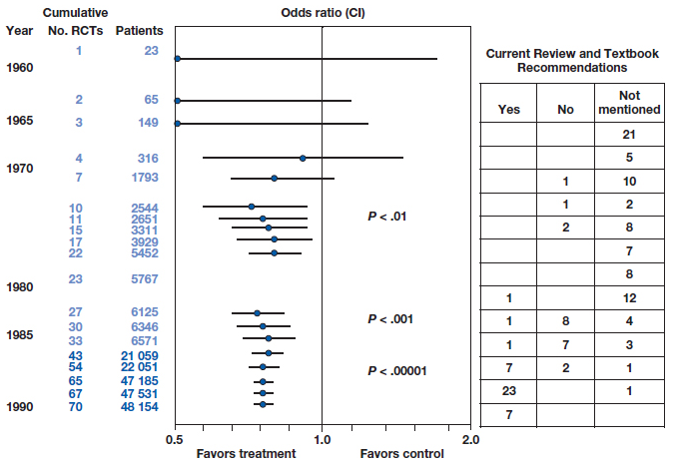
Lack of Awareness?
Back
Notes:
Antman EM, Lau J, Kupelnick B, Mosteller F, Chalmers TC. A comparison of results of meta-analyses of randomized control trials and recommendations of clinical experts: treatments for myocardial infarction. JAMA. 1992;268(2):240-–248.
Forest Plot
This is a cumulative meta-analysis of thrombolytic therapy for myocardial infarction (heart attacks). The line down the center is the odds ratio, which equals 1. So everything to the left means that the OR is < 1 and it is proven as an effective therapy. The numbers on the right are guideline recommendations for thrombolysis in myocardial infarction.
Early on the confidence intervals are very wide, by 10 trials an 2544 patients the 95% confidence intervals do not include 1 and thus the benefit is statistically significant.
Look how long it took to enter guideline recommendations! Took nearly 60 trials and > 40,000 patients before being widely accepted. This has now been supplanted by percutaneous intervention (PCI) – i.e. cardiac catheterization.
By the end, we are probably violating clinical equipoise. Clinical equipoise provides the ethical basis for medical research that involves assigning patients to different treatment arms of a clinical trial. If one therapy is clearly better than another, clinical equipoise is not met and the trial should not be allowed ethically.

Slide 21

Xigris
In 2002, the Surviving Sepsis Campaign released guidelines recommending Xigris for patients with severe sepsis (Grade B).
In 2002-2003, stories began appearing in the news about “rationing” of Xigris due to concerns about cost.
Notes:
It gave a $1.8 million grant for the study of health-care rationing practices. It successfully lobbied for a special reimbursement of half the drug's cost for Medicare patients. It hired public-relations firms that helped the drug maker shape a rationing-debate strategy. And it has rallied patients and doctors who believe in the drug.

Slide 22
Validity Concerns in PROWESS Trial
Earlier studies showed no dose-dependent response on benefit, but increased bleeding in higher doses
Study used unique definitions of both Shock and Disseminated Intravascular Coagulation (DIC)
Approval relied on subgroup analyses; subgroups had prognostic imbalance due to small size
Investigators used the APACHE-II to stratify risk of mortality. Early results seemed to show that those in the lowest quartile had increased mortality with Xigris. Patients recruited later on in enrollment period had higher APACHE-II scores, indicating they may have changed the types of patients they were enrolling
Study did not follow patients beyond 28 days (no intermediate or long-term follow-up)

Slide 23
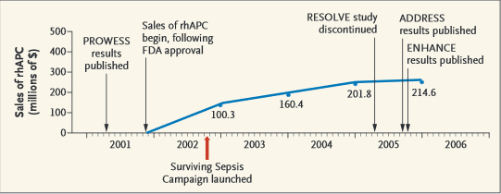
Xigris Chronology
> 90% of the funding for the Surviving Sepsis Campaign was from the Eli Lilly Company, the maker of Xigris
Notes:
Be skeptical, even of major medical journals
Very difficult to do perfect study, so everyone has issues

Slide 24
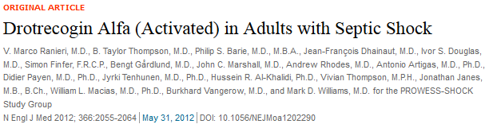
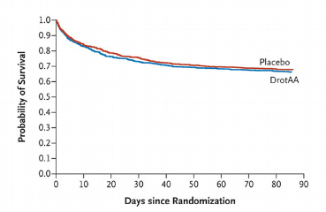
PROWESS-SHOCK Trial
Significant increase in risk of bleeding in Xigris group.

Slide 25
Why EBM?
Clinical Reasoning on the Wards
Translating Research into Clinical Skills
Shared-Decision Making and Communication with Patients
Step 1!
Leadership in Medicine

Slide 27
ASK/AQUIRE
Background Questions: General knowledge on a condition. Questions about physiology, pathology, general management.
Foreground Questions: Questions relating to decisions that need to be made regarding a particular patient’s management.
Question Format: PICO
P: Patient/Population
I: Intervention (diagnostic test, treatment, management)
C: Comparator/Control (alternative option)
O: Outcome (end result)
Notes:
All the time on the wards
ASM Spring Session in Library
InFocus 5-6

Slide 29
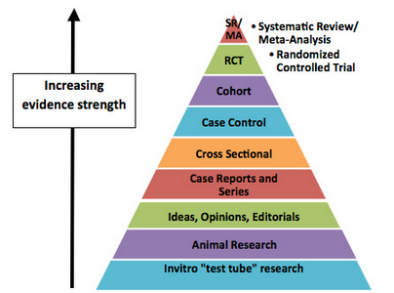
EBM Hierarchy

Slide 30
Critical Appraisal of RCTs
Threats to Internal Validity
Randomization
Allocation Concealment
Blinding
Selection / Attrition Bias
Intention-to-Treat
Results
Relative Risk (RR)
Relative Risk Reduction (RRR)
Absolute Risk Reduction (ARR)
Number Needed to Treat (NNT)
Attributable Risk (AR)
Number Needed to Harm (NNH)
Threats to External Validity / Generalizability
Setting of trial
Selection of participants
Baseline characteristics of patients
Trial protocol vs. real-life practice
Outcome measures and follow-up
Adverse effects of treatment
Notes:
Internal Validity: Stuff you learned about in InFocus1
Results: Stuff you learned about in InFocus 2 and 3
External Validity / Generalizability: Stuff we are going to be learning about going forward
Most common question I get is: haven't these already been appraised to get published in top-tier journal?

Slide 31
Our Clinical Question
Statins for patients without Coronary Artery Disease
P: In Adults without CAD
I: Does Statin therapy
C: As compared to no intervention
O: Reduce risk of cardiac death
Notes:
Just searching for statin returns 40,000 articles in pubmed

Slide 32
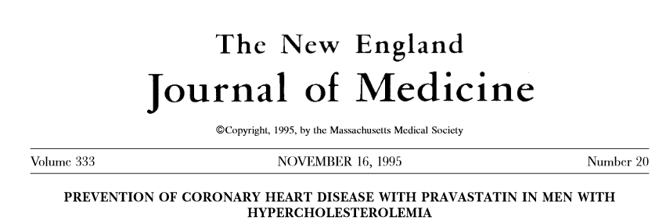
WOSCOPS Trial
West Of Scotland COronary Prevention Study

Slide 33
INTERNAL VALIDITY
Randomization (Prognostic Balance?)
Allocation Concealment
Blinding
Selection / Attrition Bias
Intention-to-Treat Analysis
Conflicts of Interest
Loss to Follow-Up
Notes:
Were patients and physicians blinded? Any differential adherence? Any other differences in the ways the two groups were treated?
Loss to Follow-Up AND appropriate length of follow-up

Slide 34
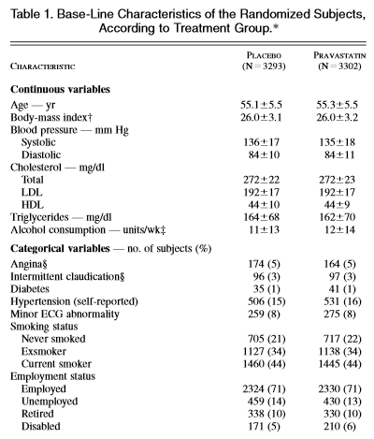
Randomization, Allocation Concealment

Slide 35
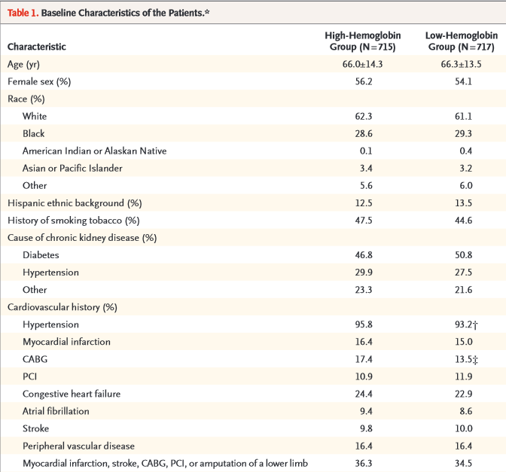
Randomization, Allocation Concealment
Notes:
CHOIR Trial, NEJM
As an example, the CAPPP trial of BB vs. ACEI for HTN treatment. Used opaque numbered envelopes to conceal randomization. At the time the study was conducted, evidence suggested that BBs were better for patients with heart disease and ACEI were better for patients with DM. Significantly more patients with heart disease were assigned to receive BBs (P 0.03) and more patients with DM were assigned to receive ACEI (p 0.04). It is possible that clinicians were opening envelopes and violating the randomization to ensure patients received what the clinicians believed was the best treatment. Thus, the prognostic balance that randomization could have achieved was prevented.
Hansson L, Lindholm LH, Niskanen L, et al. Effect of angiotensin-converting-enzyme inhibition compared with conventional therapy on cardiovascular morbidity and mortality in hypertension: the Captopril Prevention Project (CAPPP) randomised trial. Lancet. 1999;353(9153):611-–616.
All is not lost if the treatment groups are not similar at baseline. Statistical techniques permit adjustment of the study result for baseline differences. When both adjusted analyses and unadjusted analyses generate the same conclusion, clinicians gain confidence that the risk of bias is not excessive

Slide 36
Blinding
“The cumulative rates of withdrawal from treatment in the placebo and pravastatin groups were 14.9 percent and 15.5 percent, respectively, at year 1, 19.1 percent and 19.4 percent at year 2, 22.5 percent and 22.7 percent at year 3, 25.2 percent and 24.7 percent at year 4, and 30.8 percent and 29.6 percent at year 5. There was no significant difference in the withdrawal rates between the two groups at any time.”

Slide 37
INTERNAL VALIDITY
Randomization (Prognostic Balance?)
Allocation Concealment
Blinding
Selection / Attrition Bias
Intention-to-Treat Analysis
Conflicts of Interest
Loss to Follow-Up
Notes:
Were patients and physicians blinded? Any differential adherence? Any other differences in the ways the two groups were treated?
Loss to Follow-Up AND appropriate length of follow-up

Slide 38
Critical Appraisal of RCTs
Threats to Internal Validity
Randomization
Allocation Concealment
Blinding
Selection / Attrition Bias
Intention-to-Treat
Results
Relative Risk (RR)
Relative Risk Reduction (RRR)
Absolute Risk Reduction (ARR)
Number Needed to Treat (NNT)
Attributable Risk (AR)
Number Needed to Harm (NNH)
Threats to External Validity / Generalizability
Setting of trial
Selection of participants
Baseline characteristics of patients
Trial protocol vs. real-life practice
Outcome measures and follow-up
Adverse effects of treatment

Slide 39
Results
Control/Experimental Event Rates
Absolute Risk Reduction
Relative Risk Reduction
Number Needed to Treat
Adverse Event Rates

Slide 40
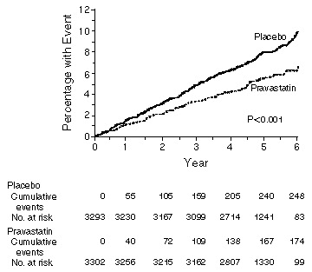
Results
Notes:
What is the primary outcome being measured? Is it of clinical relevance.
Surrogate outcomes are easy to measure, can generally be assessed sooner than actual clinical outcomes. Are common outcomes for phase 2 trials. Will usually use surrogates to see if worth doing much bigger phase 3 trial. Studies have shown that there are few reliable surrogates.

Slide 41
 | Cardiac Death | Cardiac Survival
Pravastatin | 50 | 3252 | 3302
Placebo | 73 | 3220 | 3293
Control Event Rate: Event Rate in the Control (Non-Statin) Group
Experimental Event Rate: Event Rate in the Experimental (Statin) Group
Absolute Risk Reduction (ARR): Difference between the event rate in the intervention and control groups
Relative Risk Reduction (RRR): Proportion by which the intervention reduces the event rate
Number Needed to Treat (NNT): Number of patients you would need to treat to prevent one event. = 1/ARR.
Notes:
Relative Risk Reduction vs. Absolute Risk Reduction
"Be skeptical! If huge relative risk reduction, really question study"
News loves to report RRR because it sounds so much more impressive

Slide 42
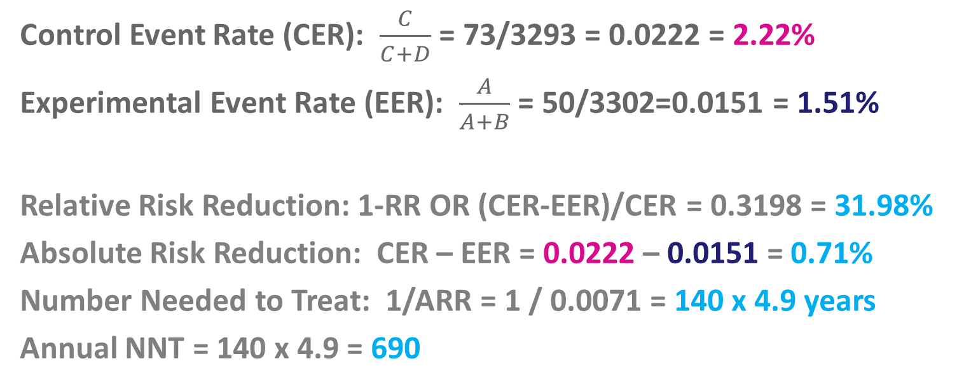
 | Cardiac Death | Cardiac Survival
Pravastatin | 50 | 3252 | 3302
Placebo | 73 | 3220 | 3293
Control Event Rate (CER): $\frac{C}{C+D}$ = 73/3293 = 0.0222 = 2.22%
Experimental Event Rate (EER): $\frac{A}{A+B}$ = 50/3302=0.0151 = 1.51%
Relative Risk Reduction: 1-RR OR (CER-EER)/CER = 0.3198 = 31.98%
Absolute Risk Reduction: CER – EER = 0.0222 – 0.0151 = 0.71%
Number Needed to Treat: 1/ARR = 1 / 0.0071 = 140 x 4.9 years
Annual NNT = 140 x 4.9 = 690
Notes:
If you can only remember one number you would want ARR. You’ll be surprised how often they won’t actually give it to you!
NNT < 100 usually means intervention is worth doing
Lots of examples of health policy workers / MPHs, clinicians, and patients being fooled by ARR vs. RRR (more likely to value high RRR because it sounds good).
When people do not specify whether they are talking about RRR or ARR—for instance, “Drug X was 30% effective in reducing the risk of death” or “The efficacy of the vaccine was 92%”—they are almost invariably talking about RRR
The complementary success of angiotensin-converting enzyme (ACE) inhibitors, antiplatelet agents, lipid-lowering agents, and β-blockers in reducing cardiac events in patients with myocardial infarction (MI) illustrates this multiplicity of disease mechanisms. Predictably, each agent offers only a modest magnitude of risk reduction (from 20% to 33%).
Very large effects are implausible because multiple mechanisms underlie most diseases, and therapies typically address only 1 or 2 of those mechanisms

Slide 43
Critical Appraisal of RCTs
Threats to Internal Validity
Randomization
Allocation Concealment
Blinding
Selection / Attrition Bias
Intention-to-Treat
Results
Relative Risk (RR)
Relative Risk Reduction (RRR)
Absolute Risk Reduction (ARR)
Number Needed to Treat (NNT)
Attributable Risk (AR)
Number Needed to Harm (NNH)
Threats to External Validity / Generalizability
Setting of trial
Selection of participants
Baseline characteristics of patients
Trial protocol vs. real-life practice
Outcome measures and follow-up
Adverse effects of treatment

Slide 44
External Validity
Selection of clinical sites and participants
Baseline characteristics of patients
Trial protocol vs. real-life practice
Outcomes measures and clinical significance
Adverse effects of treatment
Follow-Up and Study Duration
Notes:
External Validity = Generalizability
May include patients who are much more complex/sick than yours, or at much lower risk!
Beware Small Treatment Effects and Extrapolation to Very Low-Risk Patients
Pharmaceutical companies will often conduct very large RCTs to be able to exclude chance as an explanation for small treatment effects. Results are consistent with small treatment effects when either the point estimate is very close to no effect, e.g. ARR close to 0
Trial protocols can sometimes prohibit certain non-trial treatments
Setting of the trial: healthcare system, country, recruitment from primary vs. secondary vs. tertiary care, selection of participating centers and clinicians
Selection of patients: inclusion and exclusion criteria, % of patients eligible for inclusion who are included in study
Characteristics of randomized patients: baseline clinical characteristics, severity of disease, comorbidity
For example, approximately 20% of drugs that the US Food and Drug Administration (FDA) licenses are either withdrawn from the market or have major safety warnings added to the drug labels within 25 years of initial licensing

Slide 46
Application
Mayo Clinic Statin Decision Aid
Notes:
Framingham
55 male
Non-smoker
135/70
HDL 44
Total Cholesterol 194

Slide 47
Notes:
What skills do you need?
Find evidence more efficiency
Appraise the quality of the evidence more effectively
To use good quality evidence more systematically in patient care
Use a healthy dose of skepticism

Slide 48
Conclusions / Take-Home Points
EBM is an essential skill for the practicing physician
The key steps in the EBM cycle are: ASK, ACQUIRE, APPRAISE, and APPLY
Optimal clinical care involves combining individual clinical expertise and best external evidence to make diagnostic and treatment plans that take account of patients’ values and expectations
Notes:
EBM: Individual clinical expertise + best external evidence + patient values and expectations

Slide 49
Remaining EBM Curriculum
2nd Year
ASM (Fall): Preventive Medicine/Screening (Evidence Grading, Screening Recommendations) (APPRAISE, APPLY)
InFocus 4 (Spring): Critical Appraisal (APPRAISE, APPLY)
ASM (Spring): Asking Clinical Questions / PICO (ASK)
3rd Year
InFocus 5 (Fall): Searching Strategies for PubMed (ACQUIRE)
InFocus 6 (Fall): Clinical Questions, Pre-Appraised Resources (ASK, ACQUIRE, APPLY)
Clinical Rotations: Journal Club (ASK, ACQUIRE, APPRAISE, APPLY)
InFocus 7 (Spring): Communicating Evidence to Patients (APPLY)
4th Year
InFocus 8 (Fall): EBM, Industry, and Conflicts of Interest (APPLY)
Introduction to Internship (Spring): EBM on the Wards (ASK, ACQUIRE, APPRAISE, APPLY)

Slide 50
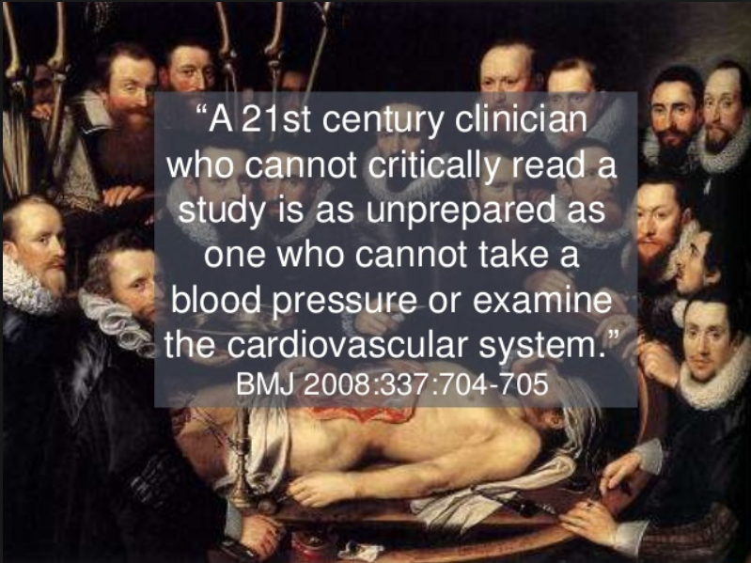

Slide 51
Introduction to
Evidence-Based Medicine
Andy Coyle, MD
Andrew.Coyle@mountsinai.org

