Slide 1
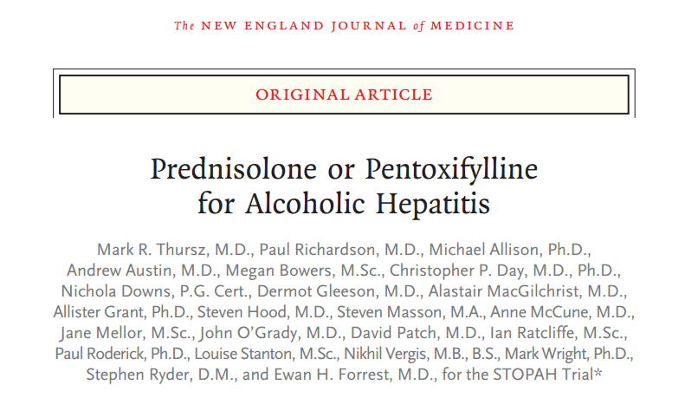
STOPAH Trial Parth Kothari, MS3

Slide 2
Case
HPI: MB is a 49 year old male with PMH of alcohol dependence disorder, hypertension, diabetes, and CKD stage 3 who presents with 3 days of abdominal pain, altered mental status and his family noticed skin has changed color over the last week.

Slide 3
Case
Vitals:
HR: 95, BP: 140/95, 96% O2 Sat, Temp: 40.0 C
PE:
HEENT: Scleral icterus
Abdomen: TTP in RUQ
Labs:
CBC →WBC: 28
PT: 18 (from baseline of 13)
LFTs →Tbili: 20, Direct: 15; AST: 450, ALT: 235
Hepatitis panel negative, blood cultures negative, UA/UC negative

Slide 4
Alcoholic Hepatitis
Inflammation of the liver from prolonged, heavy use of alcohol
In severe cases, 30-day mortality exceeds 30%
Prednisolone and pentoxifylline have both been studied for the treatment of severe alcoholic hepatitis, but no clear recommendation exists

Slide 5
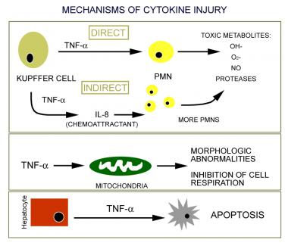
Pathogenesis
TNF and several TNF-inducible cytokines, such as interleukin (IL)–1, IL-6, and IL-8

Slide 6
Classification of AH Severity
Maddrey's Discriminant Function is useful in predicting short-term prognosis but is less useful for long-term prognosis
Discriminant function = 4.6*(increase in PT from baseline)(seconds) + Bilirubin (mg/dl)
Severe AH when > 32

Slide 7
Prednisolone Trials
2008 Cochrane meta-analysis on use of glucocorticoids in AH showed no conclusive results
However, subgroup analysis of trials with patients discriminant score > 32 showed a statistically significant reduction in mortality in patients treated with steroids, particularly in patients with severe AH
Reduction in mortality from 34% to 20%

Slide 8
Results

Slide 9
Pentoxyphylline Trials
High plasma levels of TNF-alpha have been found in patients with AH
Pentoxyphylline is an inhibitor of TNA-alpha synthesis
Largest trial in 2000 from USC, studying use of pentoxyphylline for severe AH; N=102
Inclusion – severe AH, excluded patients with active infection, GI bleed, or severe CV disease
Endpoints – Overall mortality and progression to hepatorenal syndrome

Slide 10
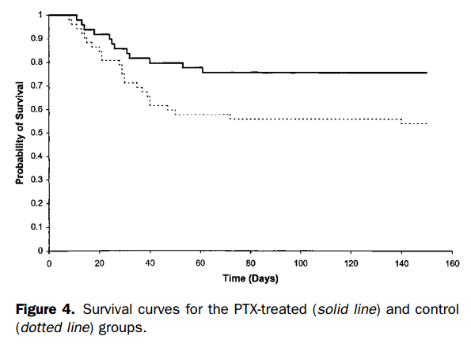
USC Trial Results
Decrease in overall mortality from 46.1% to 26.5%
Also thought to prevent hepatorenal syndrome, decrease from 34.6% to 8.2%

Slide 11
Head to Head Trials
Several small studies have compared glucocorticoids with pentoxifylline, but the results have been inconsistent
Plagued by small sample sizes which do not provide enough power to detect effect reliably

Slide 12
PICO
In patients with acute alcoholic hepatitis, does the use of predisolone or pentoxifylline versus placebo improve short term and medium term mortality?

Slide 14
Design
Multicenter, randomized, double-blind trial in the UK with N=1,103
Web-based system used to randomize patients
Patients were stratified based on geographic location and risk category
High risk patients defined by history of GI bleed, sepsis, or renal impairment prior to randomization
All other patients categorized as intermediate risk
2-by-2 factorial design
40 mg prednisolone daily
400 mg pentoxyphylline TID

Slide 15
Factorial Design
 | No Pentoxyphylline | Pentoxyphylline
No Prednisolone | Placebo | Pentoxyphylline
Prednisolone | Prednisolone | Prednisolone + Pentoxyphylline

Slide 16
Power Calculation
n = [(Z_{α/2} + Z_{β})² × {(p1 (1-p1) + (p2 (1-p2))}]/(p1 - p2)²
n = sample size required in each group,
p1 = proportion of subject cured by Drug A
p2 = proportion of subject cured by Placebo
p1-p2 = clinically significant difference
Z_{α/2}: This depends on level of significance, for 5% this is 1.96
Z_{β}: This depends on power, for 80% this is 0.84

Slide 17
Power Calculation
Calculation showed that 513 patients receiving each agent and an equal number not receiving each agent would be required to detect a reduction in 28-day mortality from 30% to 21%
Allowing for a 10% dropout rate, the study aimed to enroll 1,200 patients with 600 in each group

Slide 18
Inclusion & Exclusion Criteria
Inclusion
Clinical diagnosis of AH
Age > 18 years
80 g/day alcohol use in men & 60 g/day for women
Bilirubin > 4.7 mg/dl
Discriminant function of 32 or higher
Exclusion
Jaundice > 3 months
Cessation of alcohol consumption for more than 2 months prior to entry into the trial
Other concurrent causes of liver disease
AST > 500, ALT > 300
Previous participation in this study
Renal failure (>5.7 mg per deciliter) or dialysis
Active GI bleeding
Untreated sepsis
Requirement of pressors such as epinephrine or norepinephrine, unless condition stabilized with 7 days in hospital

Slide 19
Endpoints
Primary: 28-day mortality
Secondary: 90-day and 12-month mortality or liver transplantation

Slide 20
Consort Diagram

Slide 23
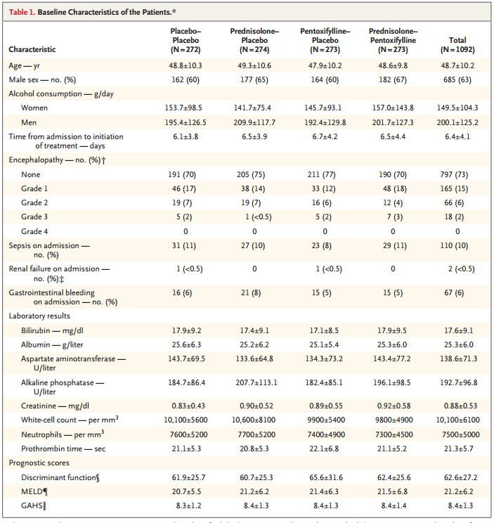
Table 1
The authors state that the groups were well-matched

Slide 24
Table 2

Slide 25
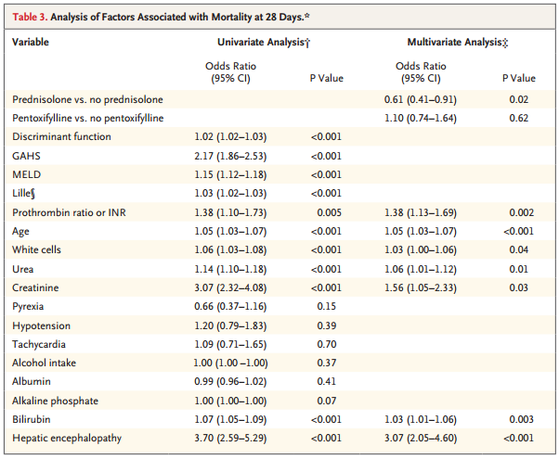
Table 3

Slide 26
Table 2 vs. Table 3
Odds ratios come from multivariate logistic regression
Table 2 shows results from prespecified analysis which only adjusted for risk category in general
Table 3 shows results after adjusting for factors affecting mortality from univariate analysis
Age, encephalopathy, white-cell count, prothrombin ratio, and serum levels of bilirubin, creatinine, urea

Slide 27
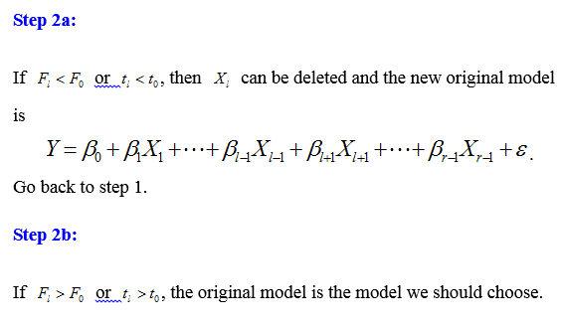
Multivariate Logistic Regression
Done with backwards elimination with p=0.05

Slide 28
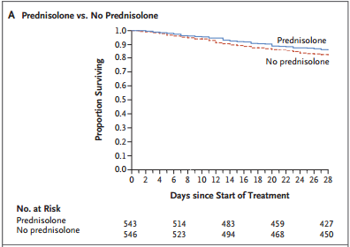
Figure 2

Slide 29
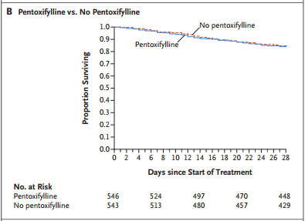
Figure 2

Slide 30
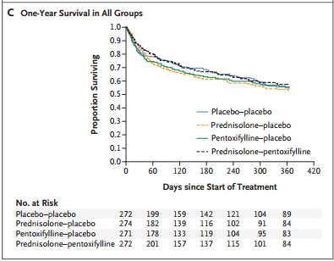
Figure 2

Slide 31
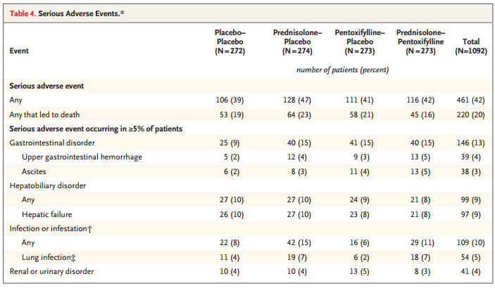
Table 4

Slide 32
Adverse Events
SAEs reported in 42% of patients, with equal distribution across treatment groups
20% of all serious adverse events resulted in death
Infection occurred in 13% of patients who received prednisolone vs. 7% who did not receive prednisolone (P =0.002)

Slide 33
Internal Validity
Patients randomized appropriately with double-blinding
Table 1 characteristics are well matched
Clinical diagnosis vs. liver biopsy diagnosis
Patients lost to follow up or unable to be analyzed for other reasons
Trial was ended early for financial reasons
33 patients not included in the 90-day or 12-month analyses
159 patients not be included in 12-month analysis

Slide 34
External Validity
Revisit key exclusion criteria →
Jaundice > 3 months
Cessation of alcohol consumption for more than 2 months prior to entry into the trial
Other concurrent causes of liver disease
AST > 500, ALT > 300
Previous participation in this study
Renal failure (>5.7 mg per deciliter) or dialysis
Active GI bleeding
Untreated sepsis
Requirement of pressors such as epinephrine or norepinephrine, unless condition stabilized with 7 days in hospital
Study population was > 60% male, > 90% white
Took place in the UK
Differences in health system?
Other factors that we are unaware of?

Slide 35
Discussion
Lower rate of mortality than other trials? (~16% at 28-days)
Though STOPAH used similar inclusion/exclusion criteria as previous trials, patients enrolled were younger with lower rates of encephalopathy
Shows the trial may not have been powered adequately
Need to weigh 28-day mortality benefit in prednisolone group with increased risk of infection
2011 trial by Nguyen et. al. in NEJM showed improved survival at 1 month in patients with prednisolone + n-acetyl cysteine vs. prednisolone alone
Patients’ relapse & amount of alcohol consumption after discharge not controlled for
Directly affects 90-day and 12-month mortality rates
Only 37% of patients stayed abstinent at 1 year (self-reported)

Slide 36
Our Patient
49 year old male with PMH of alcohol dependence disorder, hypertension, diabetes, and CKD stage 3 who presents with severe AH
What would you treat with?
What recommendations do you have for him?
Abstinence is the only factor associated with long-term survival in these patients

