Slide 1
REDCap Session
Hernis De La Cruz, BS
December 1st, 2017
Center for Biostatistics
Department of Population Health Science and Policy
Icahn School of Medicine at Mount Sinai

Slide 2
Contents
REDCap at ISMMS
REDCap Features
Basic project workflow
Questions

Slide 3
REDCap at ISMMS

Slide 4
REDCap
Research Electronic Data Capture:
Web based application used to create and manage databases and surveys (http://www.project-redcap.org/ )
Created by the informatics core at Vanderbilt University in 2004 with ongoing support from CTSA
2,600+ institutional partners
117 countries
~ 474K projects
629,000+ users
Notes:
Stats as of 11/30/17
http://www.project-redcap.org/
Vanderbilt dynamically issues bug fixes and version updates.

Slide 5
REDCap at ISMMS
Since November 2011
Current version REDCap v7.4.9 (updated August 2017)
REDCap Link: https://www.inchoir.org/redcap/
Can be used by any Mount Sinai employee or student at no cost (access can be given to non-MS employees)
Currently we have:
1,700+ active users*
1,700+ projects (excluding “practice” projects)
Notes:
As of 11/30/17
*any activity within the past 6 months

Slide 6
REDCap Features

Slide 7
Features
Access and Security
Cross platform
Secure hosting and encrypted web app
Daily data backups
User rights (controlling level of access)
Notes:
Built for research

Slide 8
Features
Access and Security
Multi site access
Remote access
Mobile friendly version for data collection
Offline data collection (mobile app)
Notes:
Built for research

Slide 9
Features
REDCap Mobile App:
The use depends on if access is given
It is an app that can be installed on a tablet or mobile device.
Can be used to collect data offline when there is no WiFi or cellular connection, and then later sync data back to the server.

Slide 10
Features
Data protection:
Mark identified data and create access limits
Researchers choose what people and groups have access to:
Data, identified or de-identified
Data export and import
View logging (data trail):
Who and when accessed or changed the project / data

Slide 11
Features
Fast and flexible project development:
Autonomy creating new databases/surveys
Web interface for form creation and data collection
Modifications can be made at any point of the study
Databases can be copied
File repository

Slide 12
Features
Capabilities:
Calculated fields and branching logic
Designed as a ‘one size fits most’ solution
With programming help can be very customizable
Basic reporting capabilities
Not a statistical analysis software

Slide 13
Features
Data export tools:
Researchers can export data to a variety of statistical analysis software (R, SAS, SPSS, Stata, or XML)
Data exports are customizable (download only selected variables)
Exports can include identified or only de-identified data depending on user rights

Slide 14
Data Collection Types (Modules)
Classic - only one event
Longitudinal – repeated events (time points)
Survey
Randomization

Slide 15
Project Phases
Development – learn, build, test
Real data should NOT be entered until the project has been moved to the Production Phase.
Production – collect, analyze, report.
Draft Mode – data form updates

Slide 16
Surveys in REDCap
Should be enabled in ‘Online Designer’ tab
Can be sent to subjects individually using email address
One generic link can be posted on the website or sent to everyone
Can send survey reminders to those who have not yet responded
Follow-up surveys can be automated
Needs an email to be linked to a record
Notes:
Difference b/w arms and events

Slide 17
Basic Project Workflow

Slide 18
General Orientation
*** Automatic log out after 60 min of inactivity

Slide 19
Instrument Design
*When you upload a data dictionary it
over-writes the entire online database
Metadata driven
Data dictionary (csv file)
Create/update database using web app
Data dictionary
Variable / field name (study_id)
Form name (demographics)
Field type (text)
Field label (Study ID)
*** Make sure to periodically save versions of your data dictionary

Slide 20
Sample Data Dictionary
*Cannot repeat
*Form names need to be grouped

Slide 21
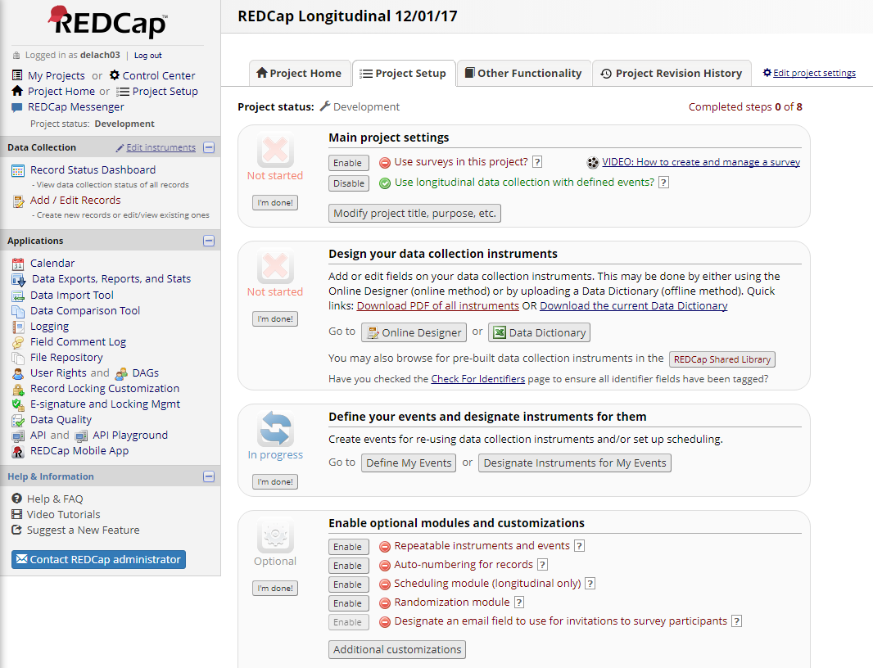

Slide 22
Download your own to share
Upload a given data dictionary

Slide 24
User Rights

Slide 25
https://www.seton.net/redcap/faqs/add-users-define-user-rights/

Slide 26
Instrument Design
Notes:
* Importing from REDCap Shared Library is blocked by MS network.

Slide 27
Creating Fields (Variables)
Field Types:
Text box
Radio Buttons
Drop-down list
Check boxes
File Upload
Slider
Yes-No
True-False
Calculated Field
File upload (one per field)
Descriptive text
SQL

Slide 28
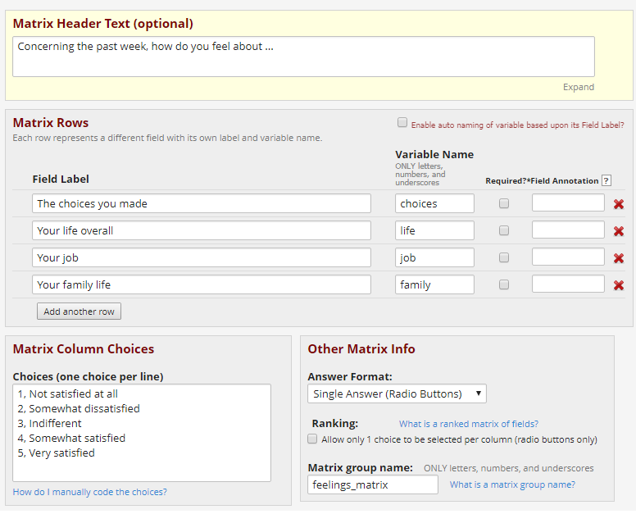
Matrix Field
Can be radio button (one choice) or checkboxes
Can also be formatted as one choice per column

Slide 29
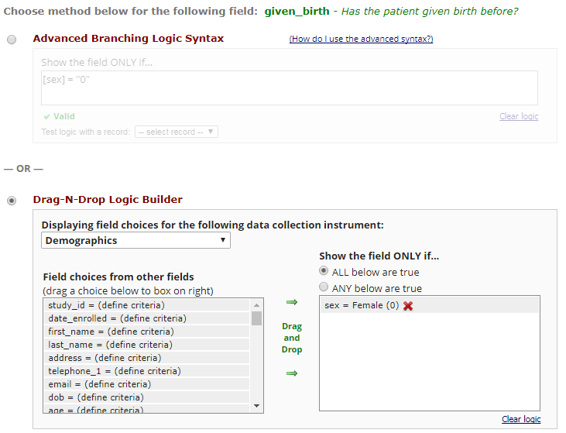
Branching Logic
Hiding / Showing fields
Logic based
Drag and Drop or syntax based

Slide 30
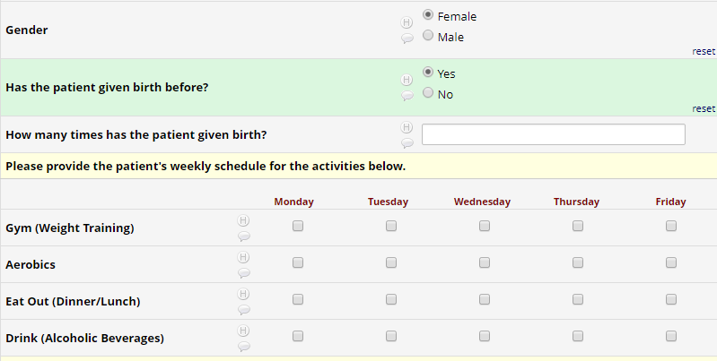
Male
Female

Slide 31
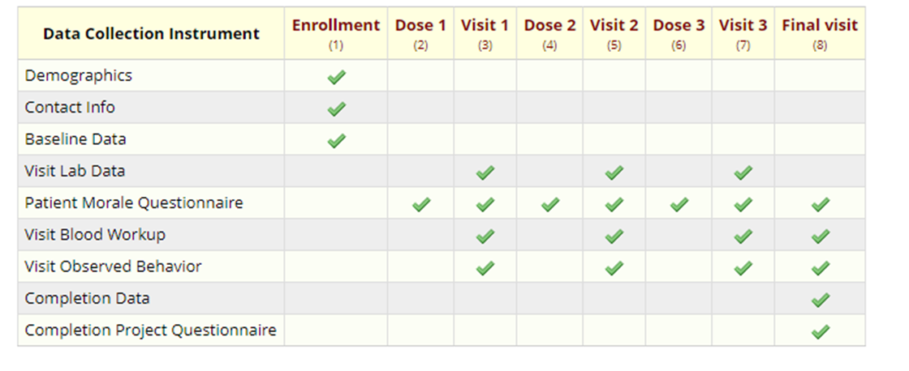
Longitudinal Studies
Ideal for clinical trials
Predefined events, arms, and forms
Notes:
Difference b/w arms and events

Slide 32
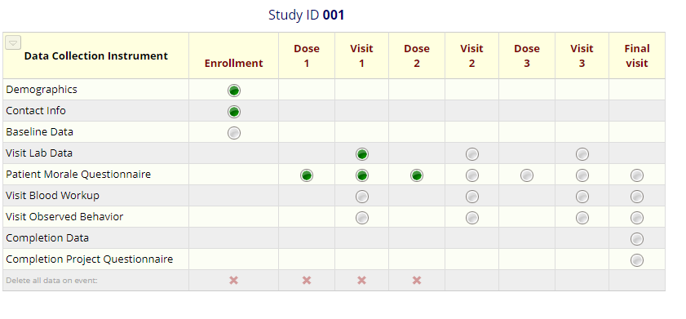
Longitudinal Studies

Slide 33
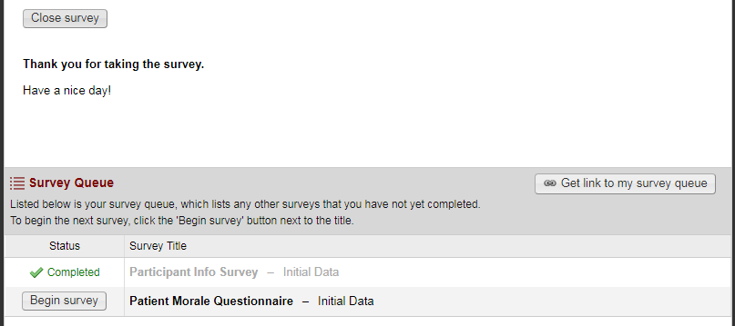
Survey Queue

Slide 34
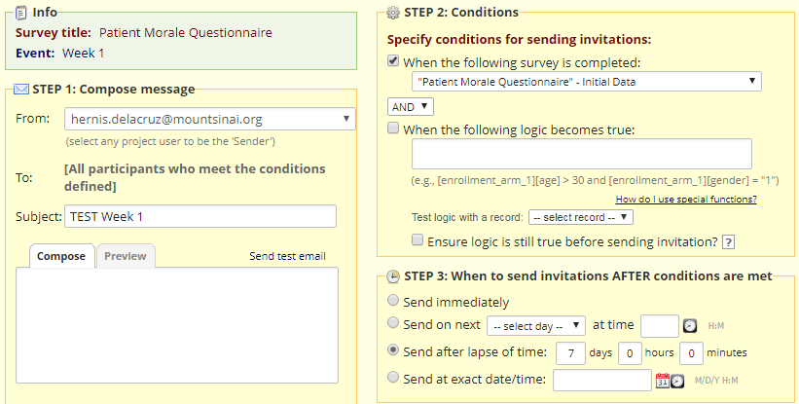
Survey Automated

Slide 35
Survey Automated
*Completed the survey at 1:53PM on 11/30/17

Slide 36
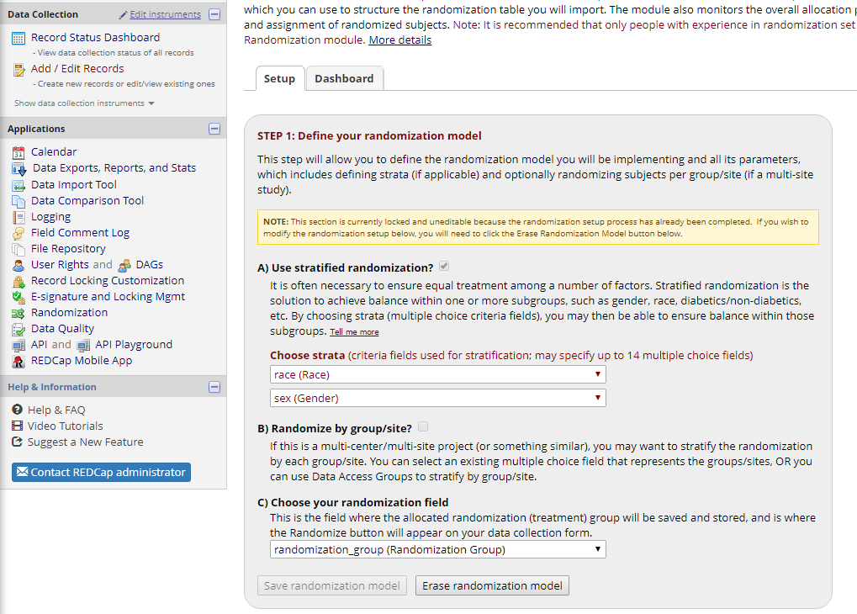
Randomization
*Randomization field needs to be a radio or dropdown field

Slide 37
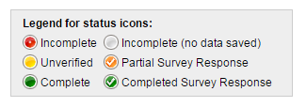
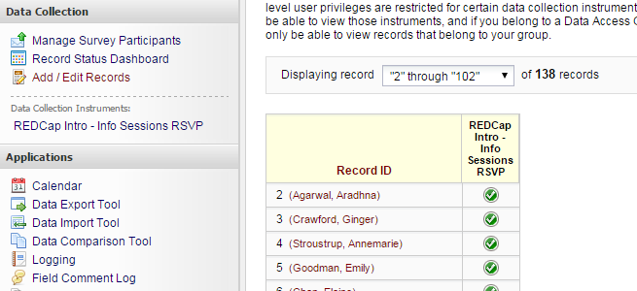
Data Entry
Record status dashboard
Add / Edit records
Bulk upload via csv file

Slide 38
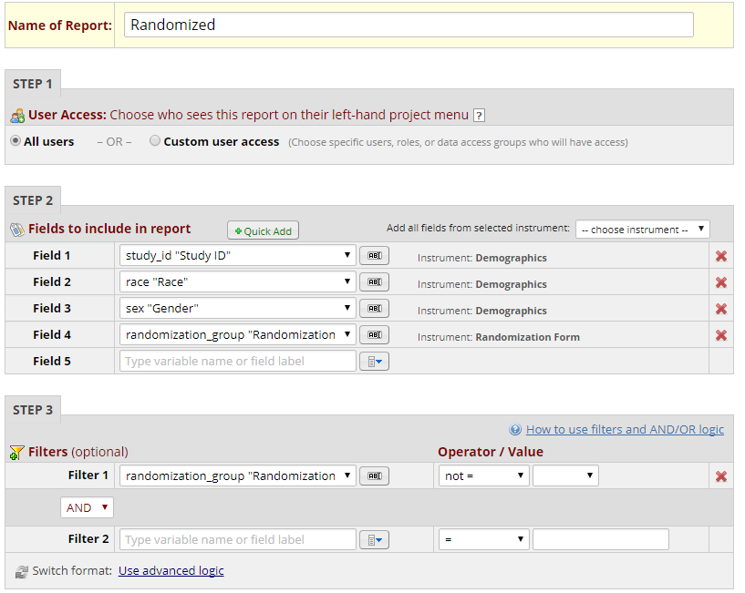
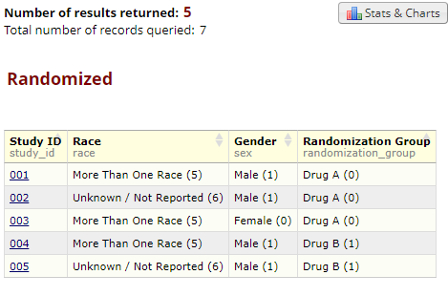
Report Builder
***Great for data
quality and quick
updates
Notes:
REDCap is not a Statistical Software!

Slide 39
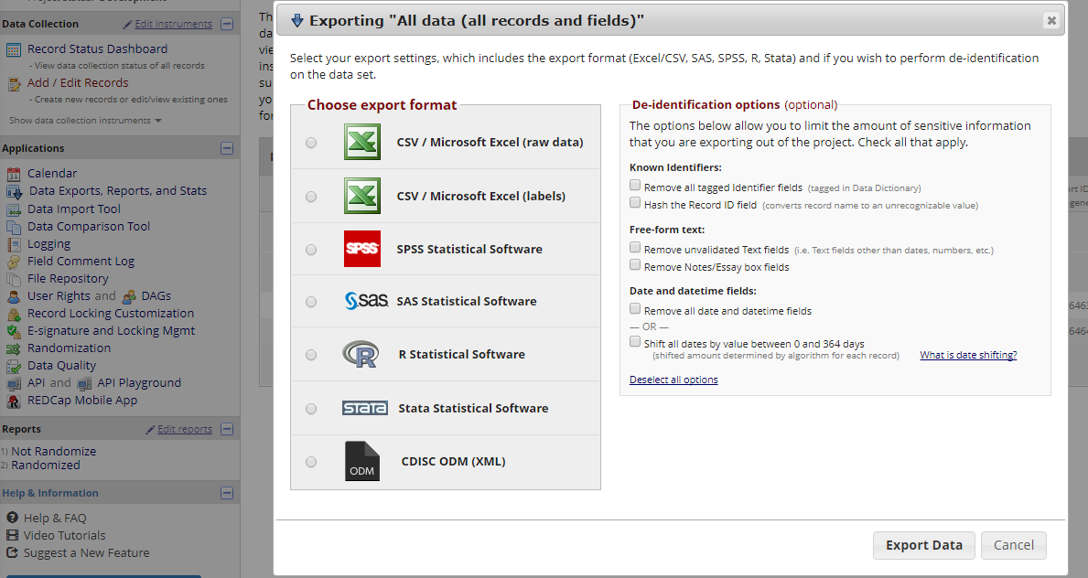
Data Export

Slide 40
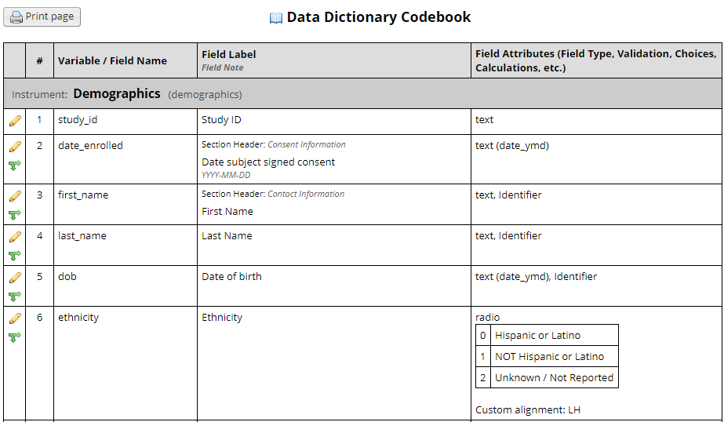
Codebook
**Send it with your raw data to a statistician

Slide 41
Pre-Production Check List
Design data collection instruments
Test instruments
Assign user rights
Move project to production (with an option to delete all existing data)
* Takes about 1 business day to approve the move to production

Slide 42
Making Changes in Production
Change steps:
Online Designer -> Enter Draft Mode
Modify forms
Review your changes
Submit changes for approval
** 1 -2 business days for the approval process
~Before making any changes to the database make a local back up of your data~

Slide 43
Making Changes in Production
Potential for data loss when:
Change/delete variable name
Change answer choices
Change field type from text to radio buttons or dropdowns
Remove an event or a form
More info here:
https://rc.partners.org/kb/article/2093

Slide 44
REDCap Responsibilities
Study Team
ISMMS
Project set up and design
User rights management
Regulatory approval to use REDCap
Request to move project to production
Inform ISMMS when project is completed
Staff training for data entry
Data management policies and procedures
Test database before moving it to production
Host secure, reliable REDCap software
Periodically upgrade REDCap software
Enable advanced project features (i.e., double data entry)
Move projects to production
Review project changes in production mode to prevent data loss and secure data integrity
Provide limited technical support for difficult problems

Slide 45
REDCap Help
Help and FAQ
https://www.inchoir.org/redcap/redcap/index.php?action=help
Video training modules
https://www.inchoir.org/redcap/redcap/index.php?action=training
https://projectredcap.org/resources/videos/

Slide 46
HTML Help
Below is a link of HTML that can be used for fields in REDCap. HTML can be used in any field (Begin new section field, answer fields, and descriptive fields)
https://labkey.med.ualberta.ca/labkey/wiki/REDCap%20Support/page.view?name=rchtml

Slide 47
Citing REDCap
Study data were collected and managed using REDCap electronic data capture tools hosted at [YOUR INSTITUTION].1 REDCap (Research Electronic Data Capture) is a secure, web-based application designed to support data capture for research studies, providing 1) an intuitive interface for validated data entry; 2) audit trails for tracking data manipulation and export procedures; 3) automated export procedures for seamless data downloads to common statistical packages; and 4) procedures for importing data from external sources.
1Paul A. Harris, Robert Taylor, Robert Thielke, Jonathon Payne, Nathaniel Gonzalez, Jose G. Conde, Research electronic data capture (REDCap) – A metadata-driven methodology and workflow process for providing translational research informatics support, J Biomed Inform. 2009 Apr;42(2):377-81.
Link to article:
http://www.sciencedirect.com/science/article/pii/S1532046408001226
https://projectredcap.org/resources/citations/

Slide 48
Contact
redcap-support@mssm.edu

Slide 49
~ THANK YOU ~

